Slide 1


DevSecOps Deciphered
AtlSecCon 2023
Sunny Jamwal
Director of CyberSecurity

Slide 2
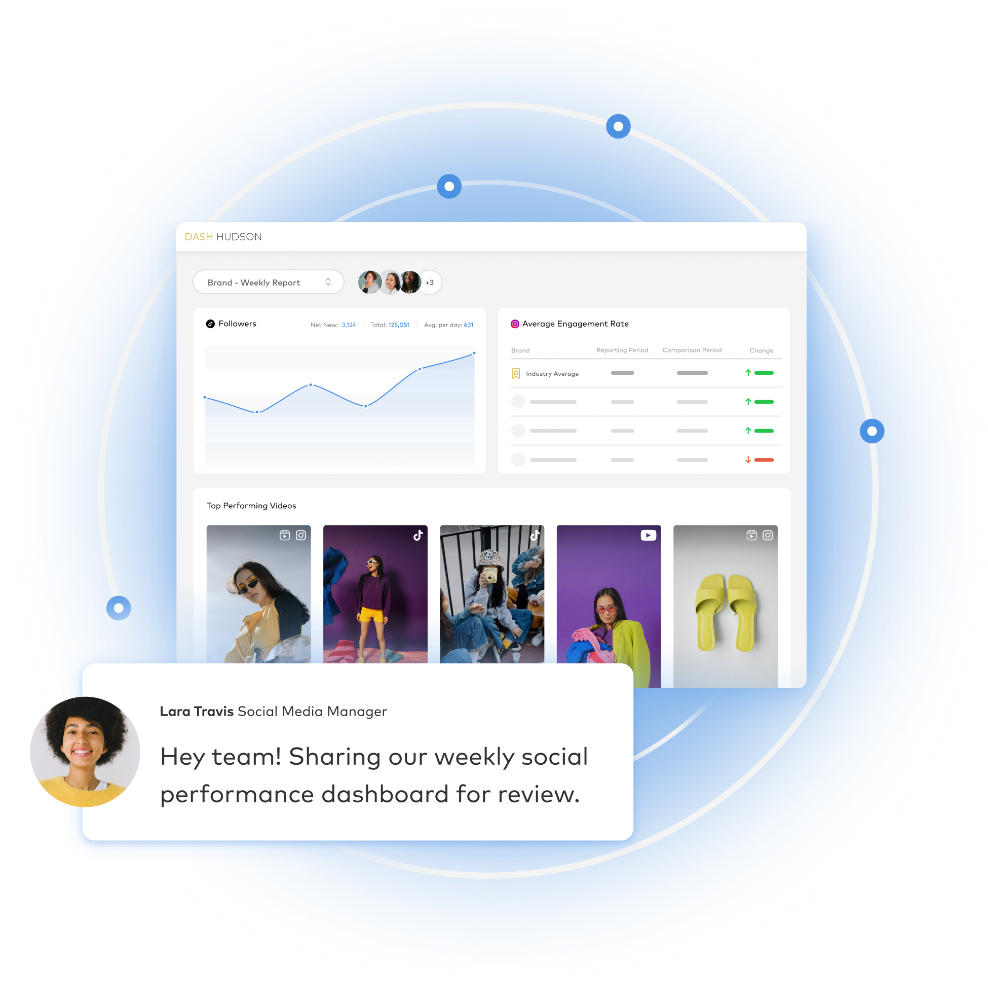






Outsmart Social
A social media management platform that delivers sophisticated insights and workflow tools, keeping you in the know and saving you time — so you and your team can get back to marketing.
TRUSTED BY BRANDS OF ALL SIZES

Slide 3


Slide 4
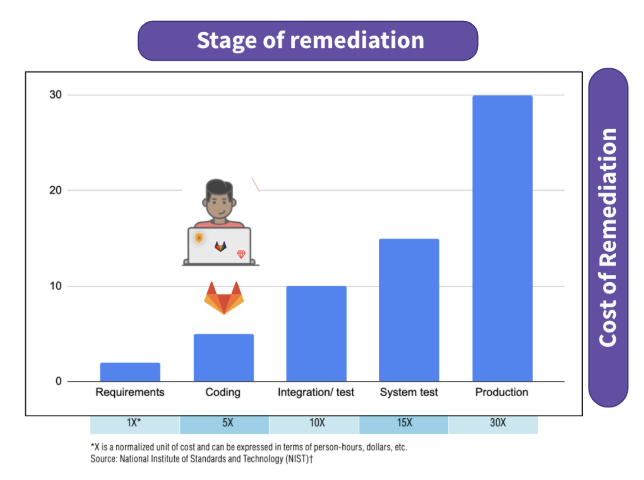

Slide 5
DevOps
HISTORY
2007
2008
2009
2010-2012
2013
2022
Patrick Debois
Andrew Shafer meets Patrick Debois
10+ Deploys a Day: Dev and Ops Cooperation at Flickr
DevOps Meetups
The Phoenix Project - Gene Kim
GitLab Survey 44% Organizations use DevOps Practices

Slide 6
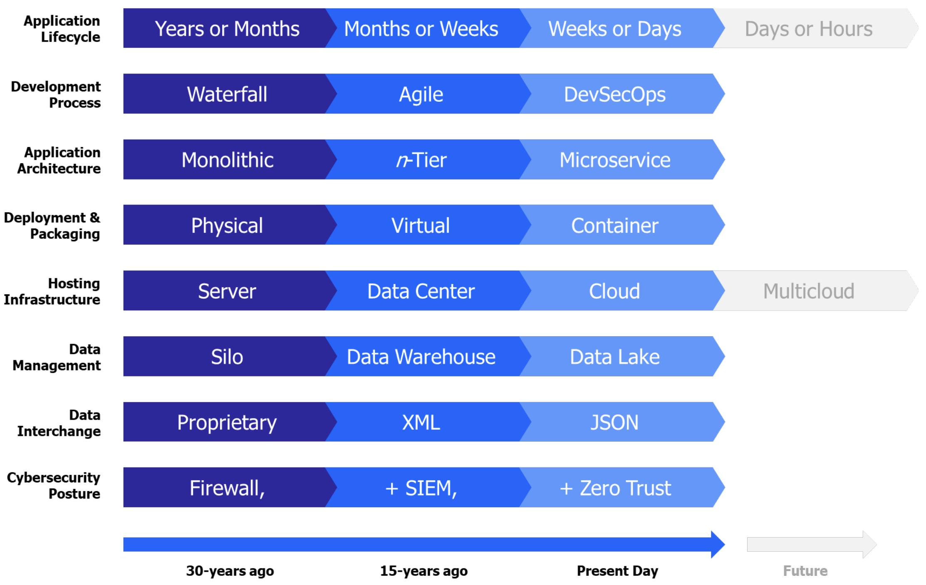

Slide 7
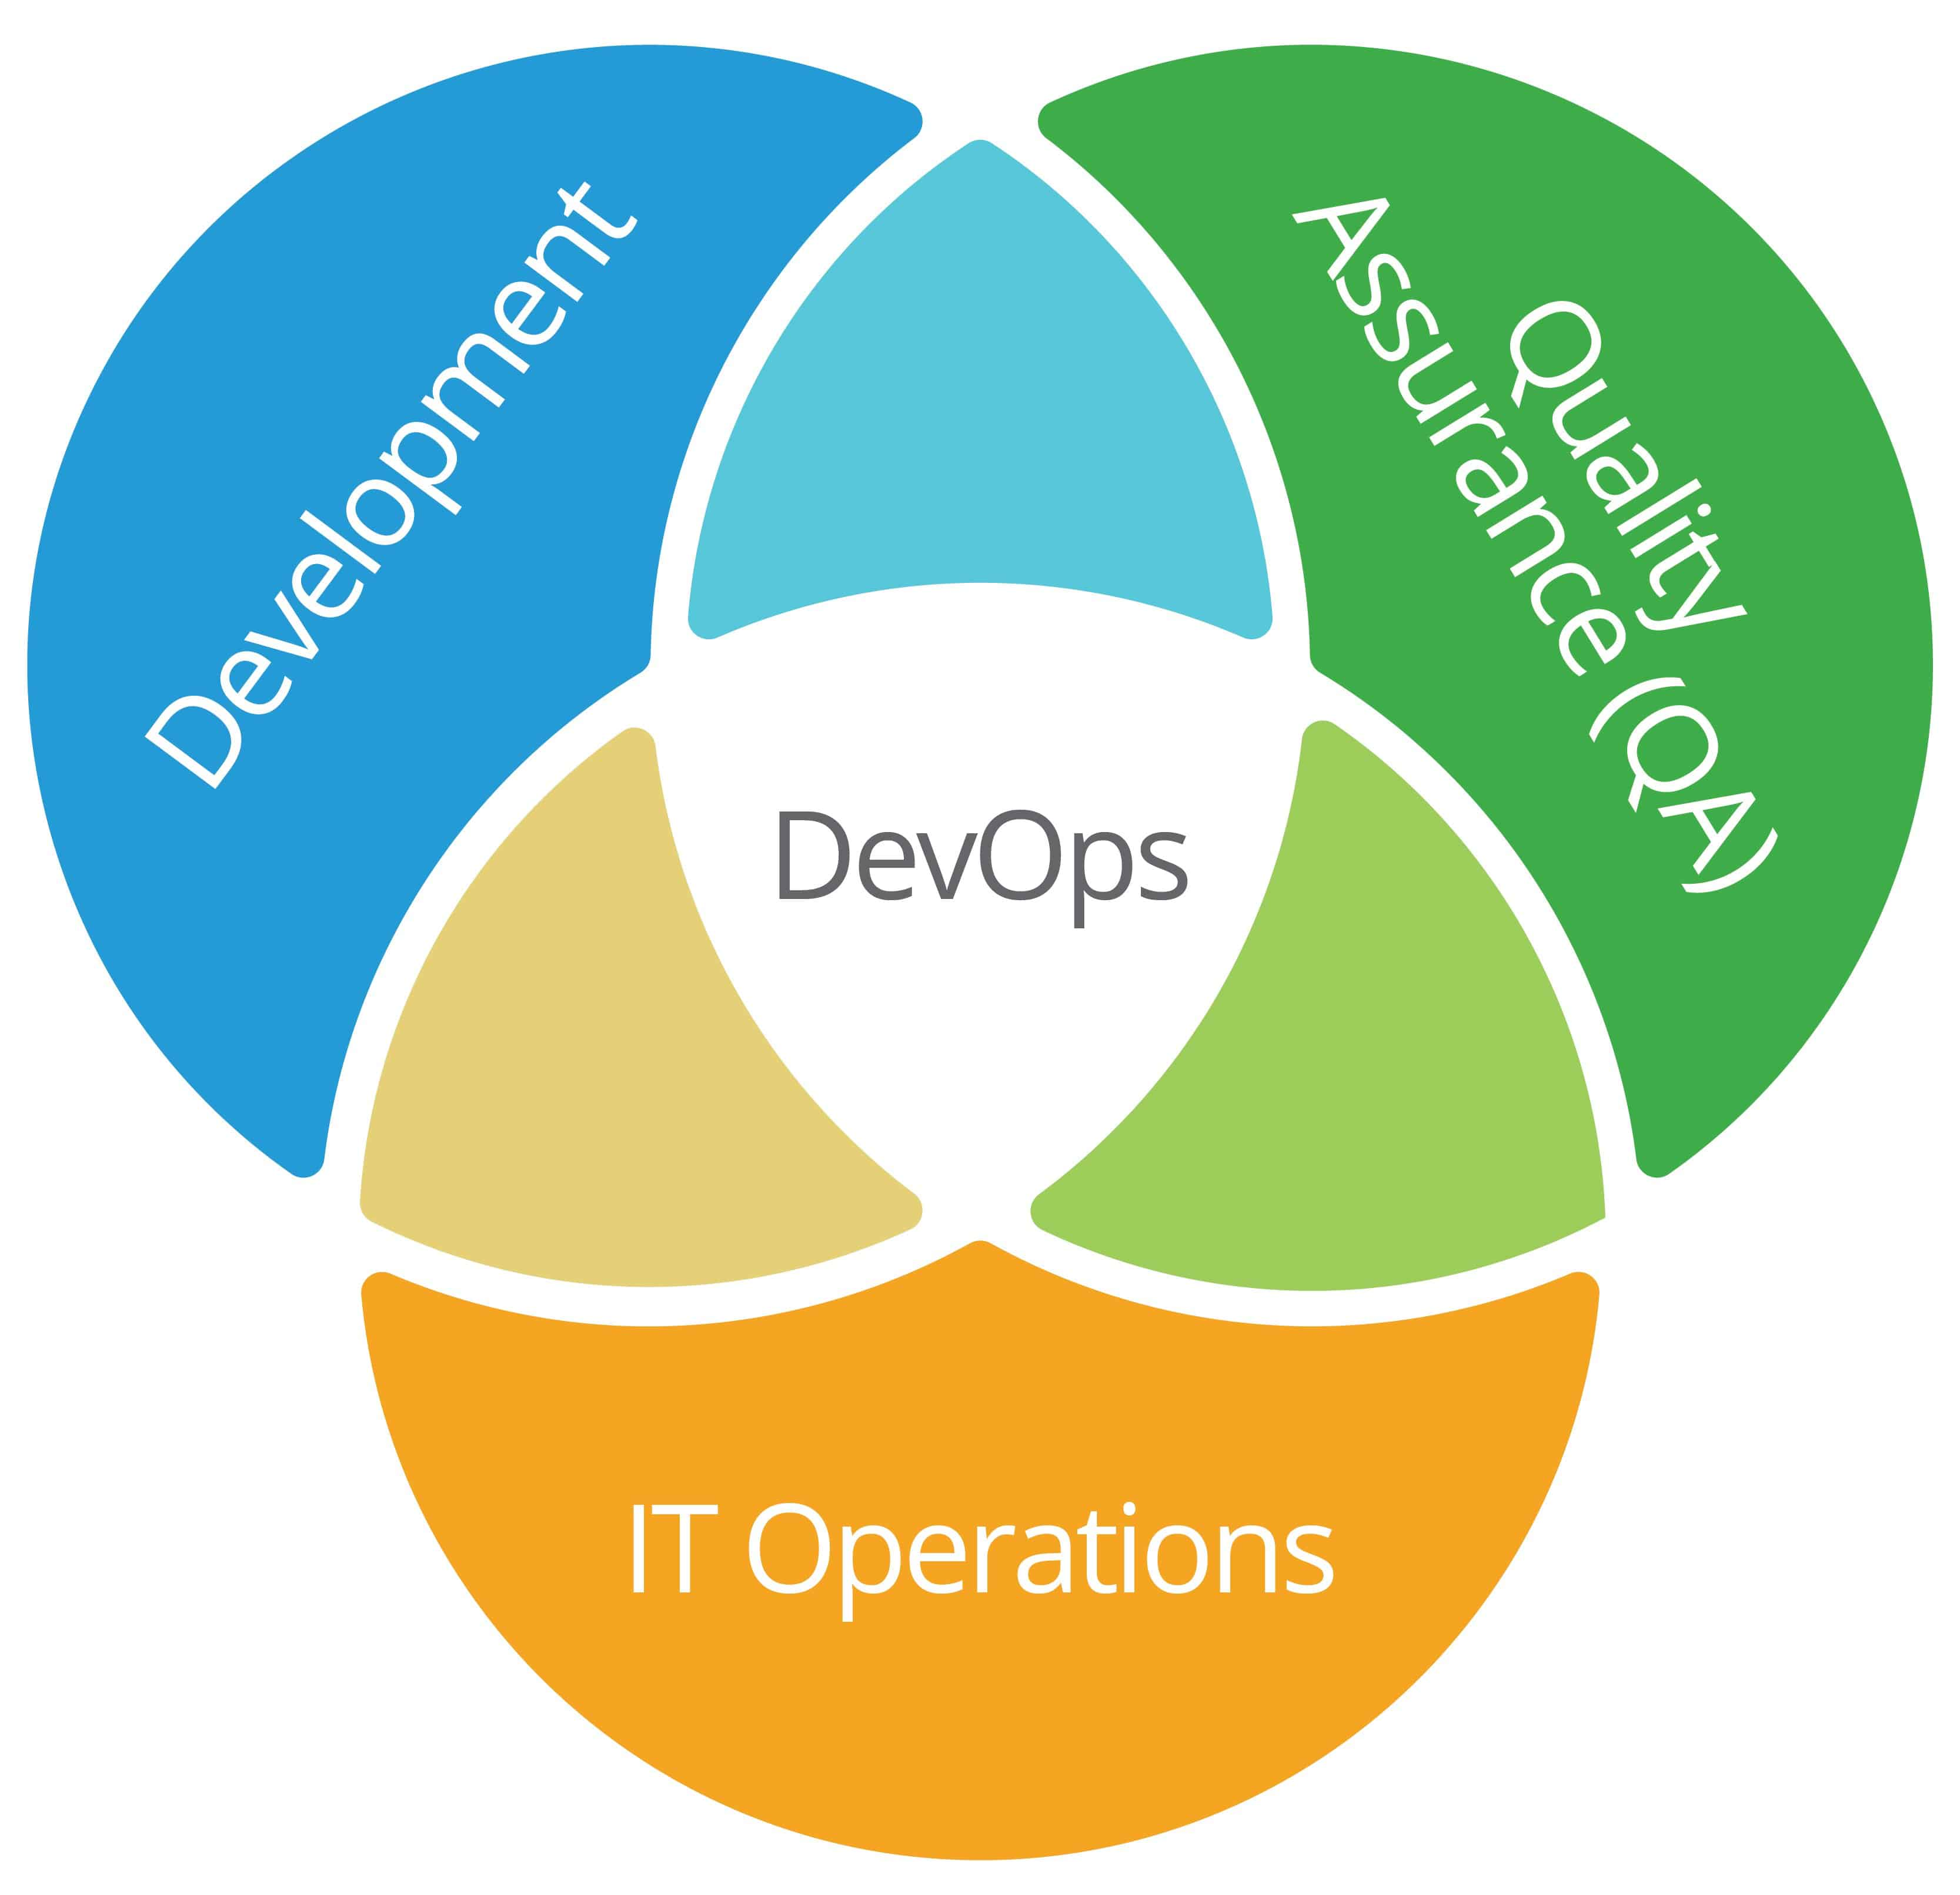
Microservices
Containers
Kubernetes
CI/CD
Cloud

Slide 8
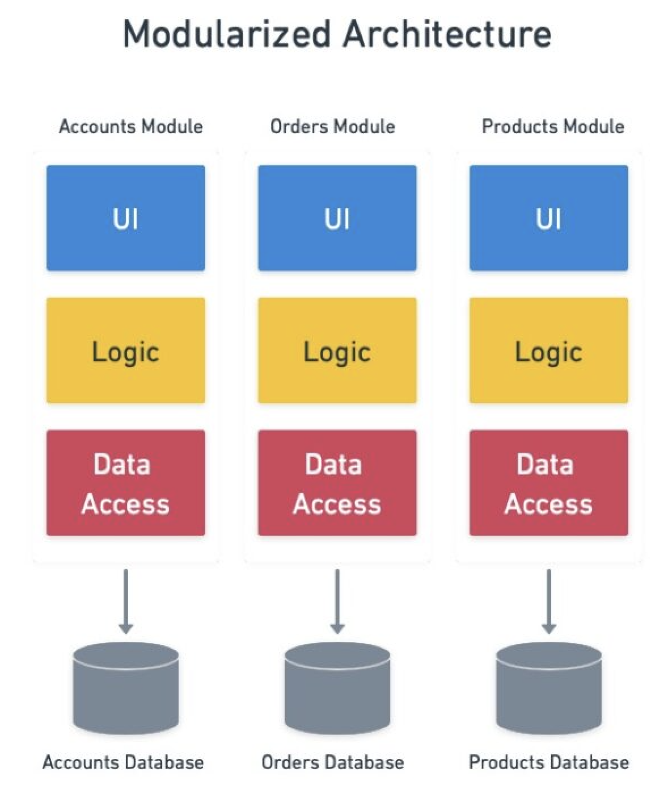
Microservices
Autonomous
Agility
Technological Freedom
Resilience

Slide 9
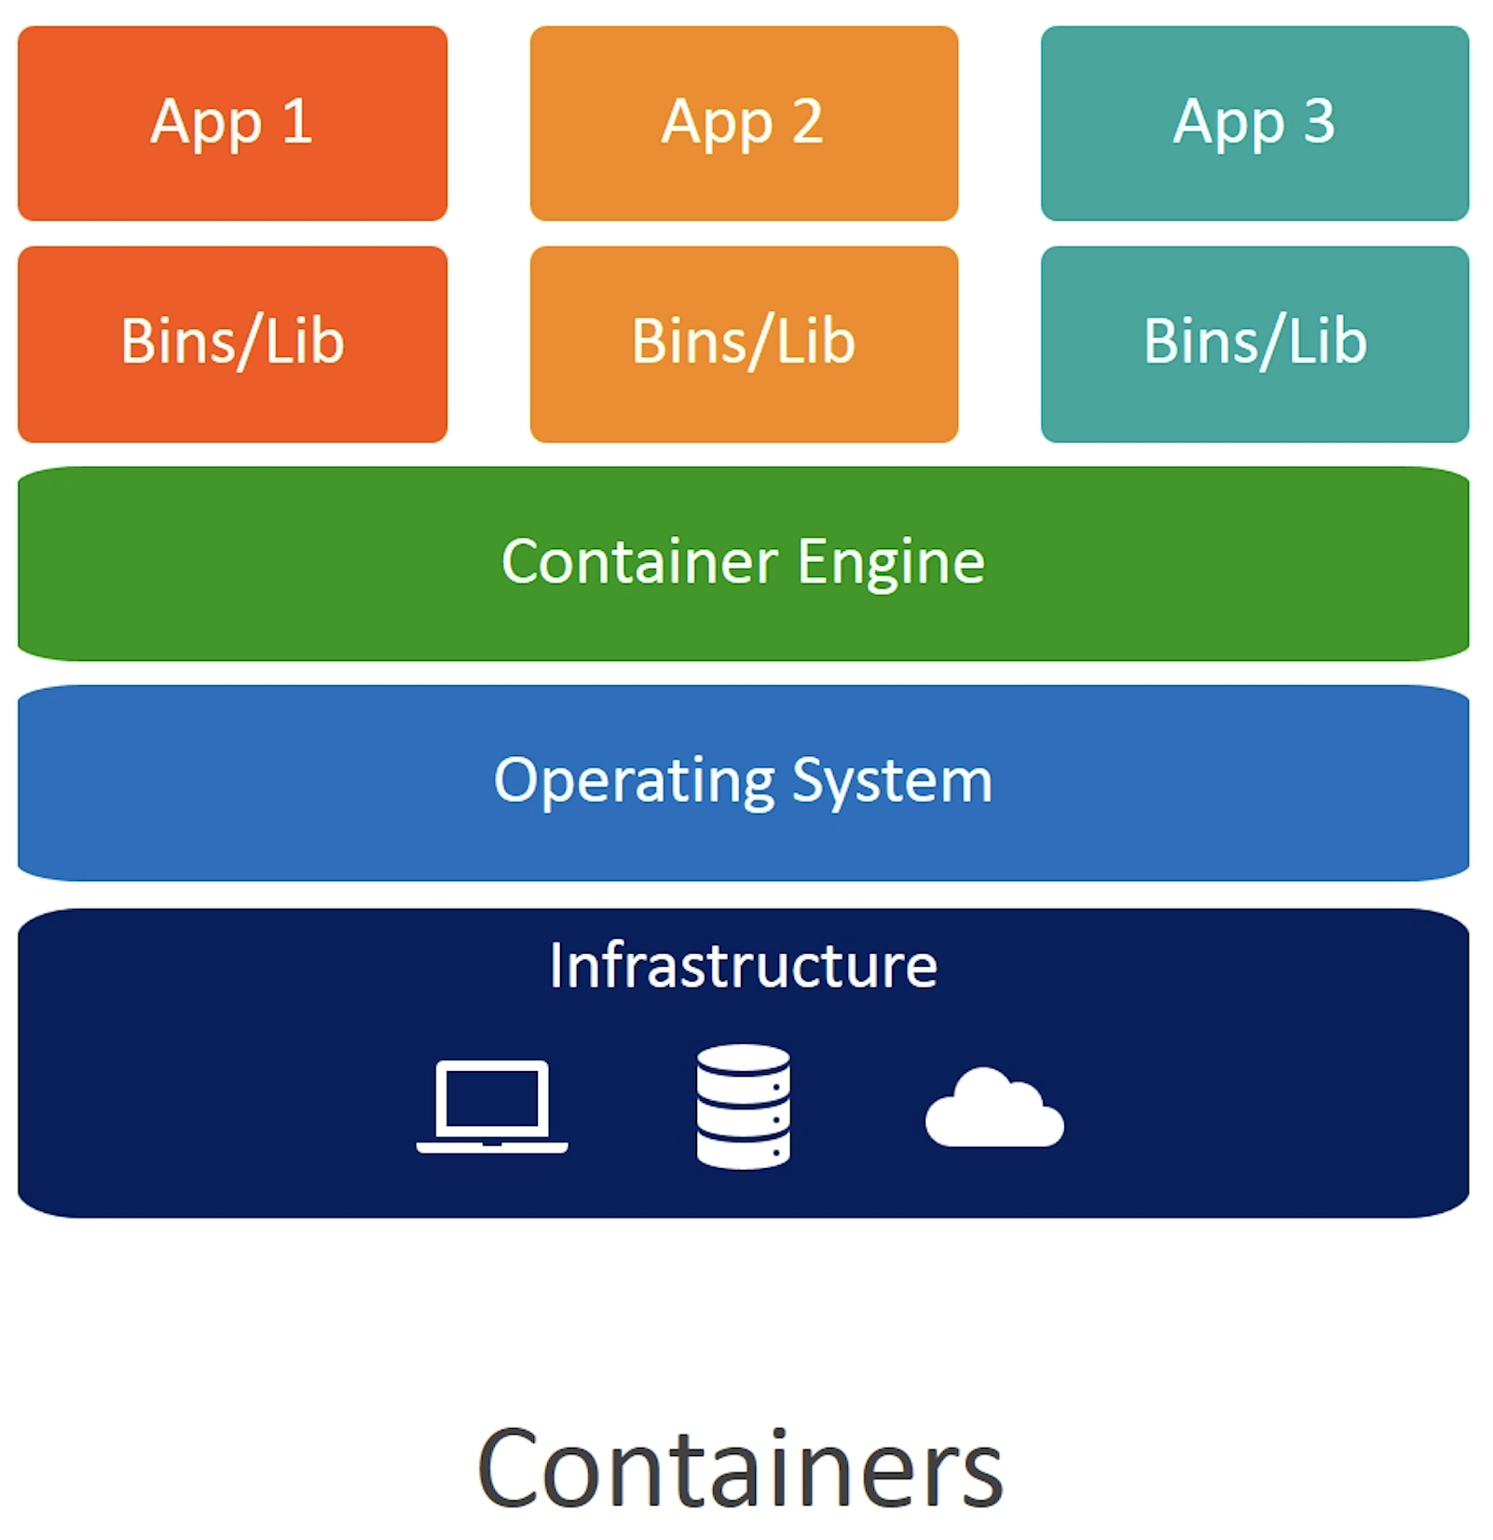
Containers
Containers virtualize an OS in order to run multiple applications in one OS.
VMs virtualize hardware to run multiple OS.

Slide 10
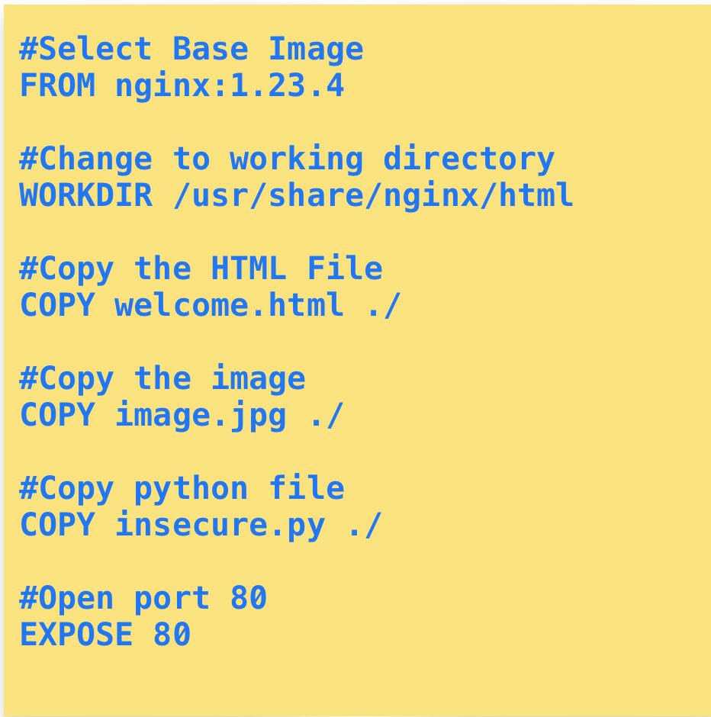

Slide 11
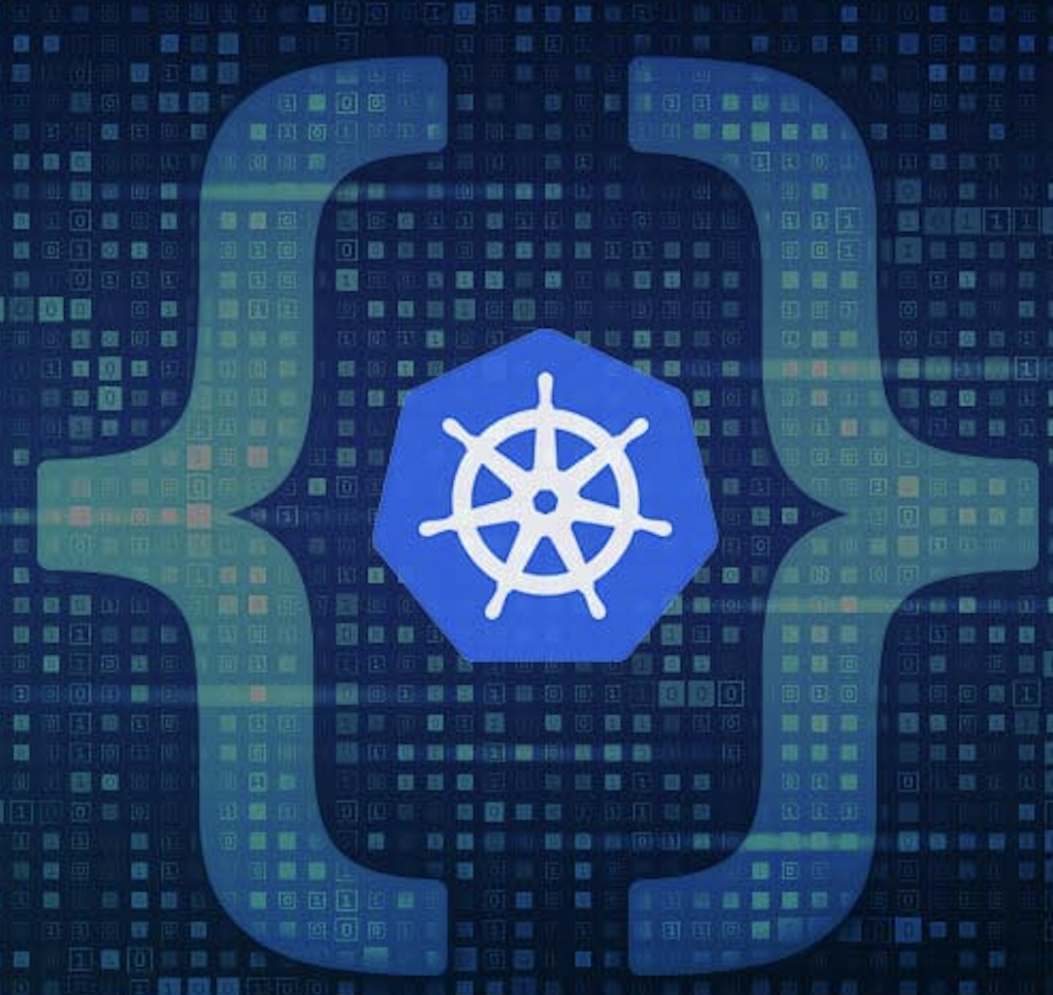
Kubernetes
Kubernetes was developed by Google before being open-sourced in 2014.
Kubernetes is a descendant of Borg, a container orchestration platform used internally at Google.
Kubernetes is an orchestration platform for containers.
Kubernetes handles the computing, networking, and storage on behalf of your workloads.

Slide 12


Slide 13
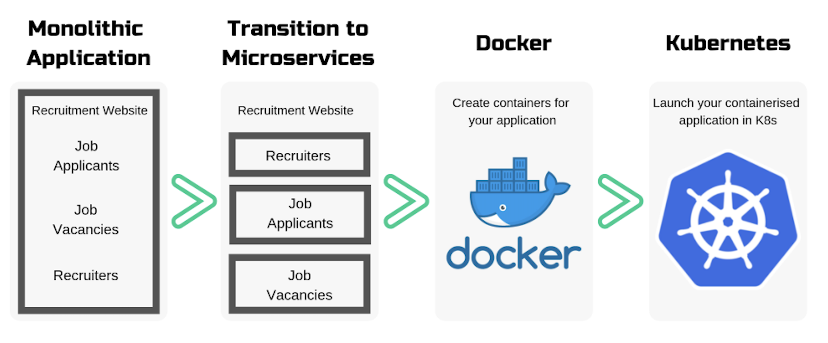

Slide 14
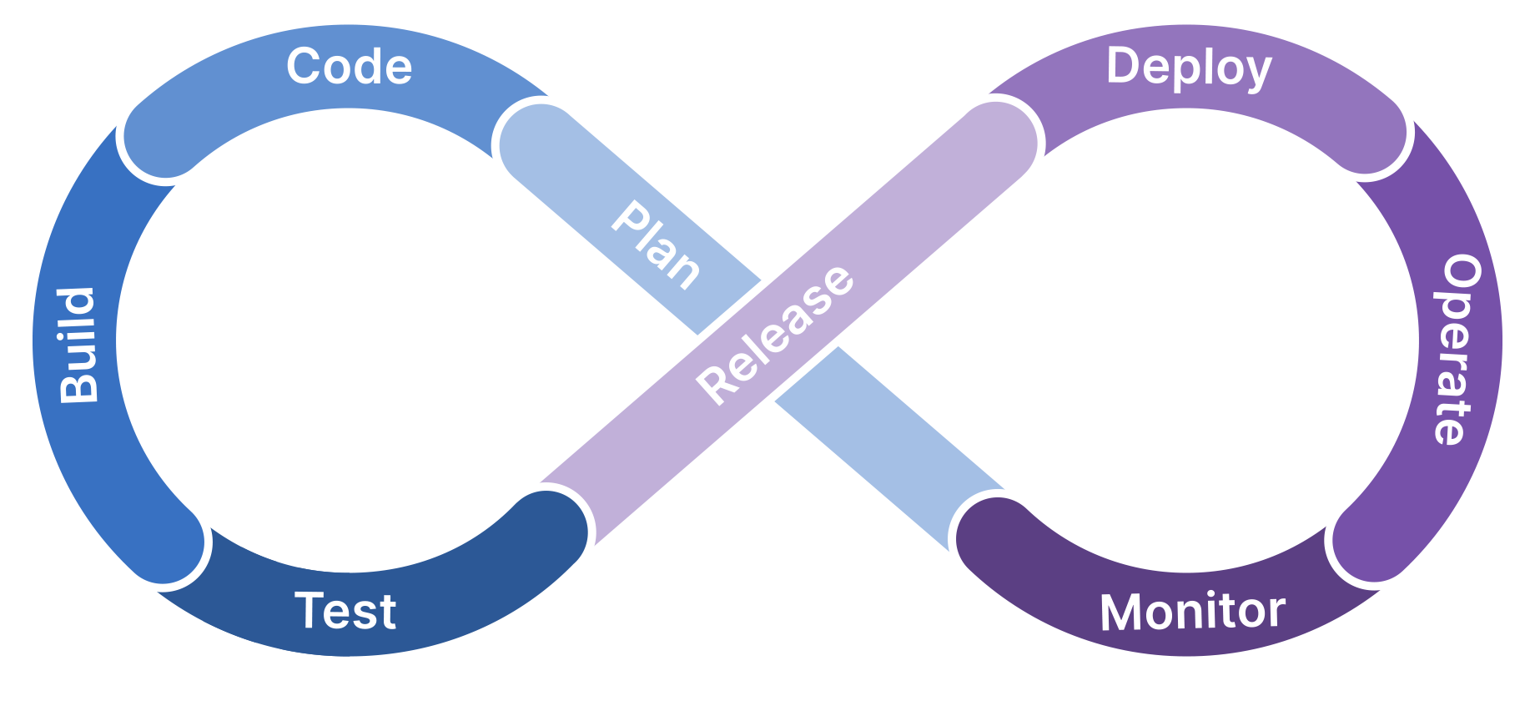
Continuous Integration / Continuous Development

Slide 15
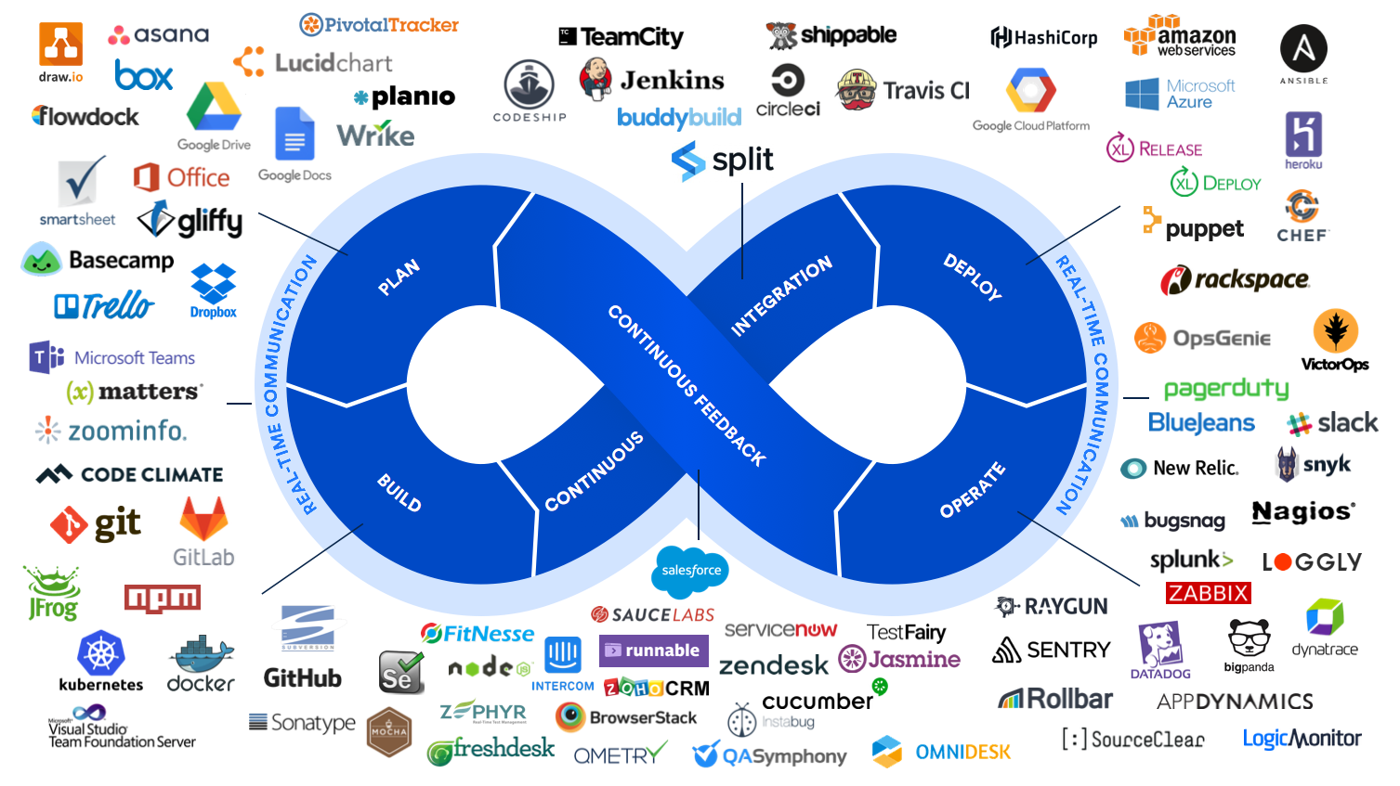

Slide 16
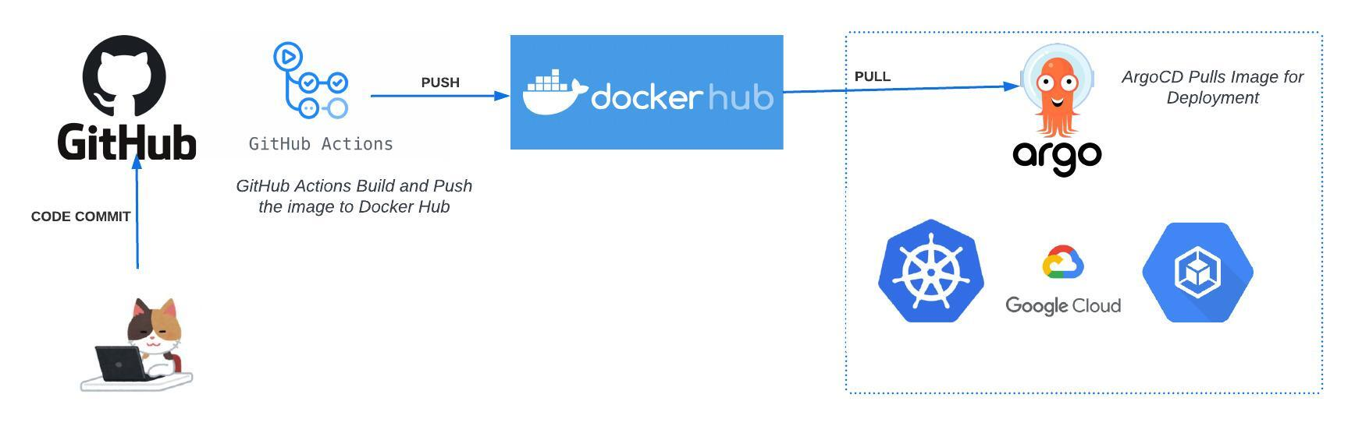

Slide 17
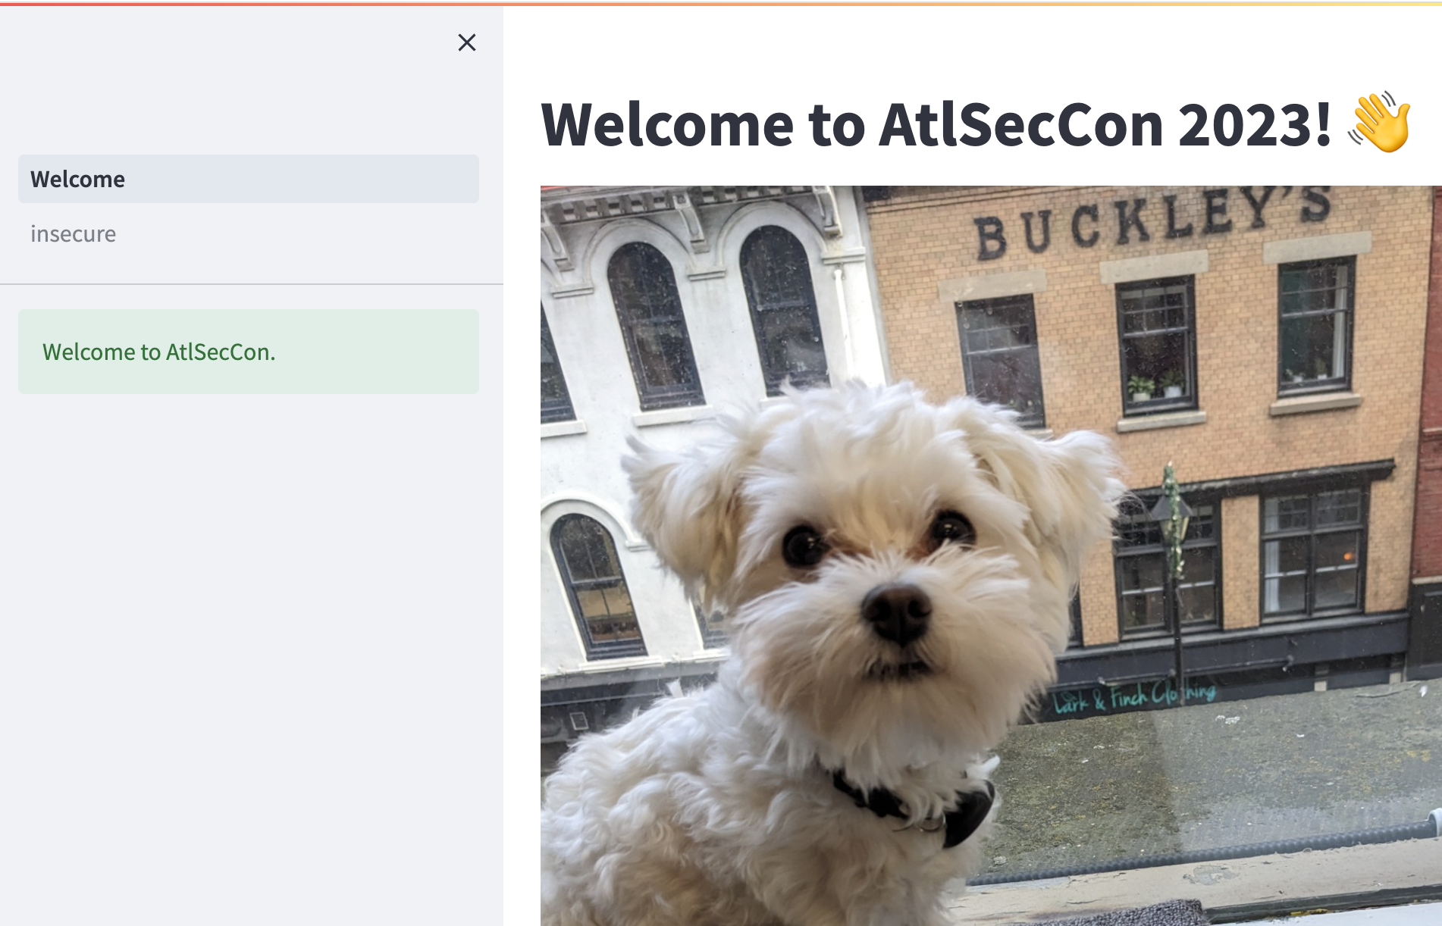

Slide 18
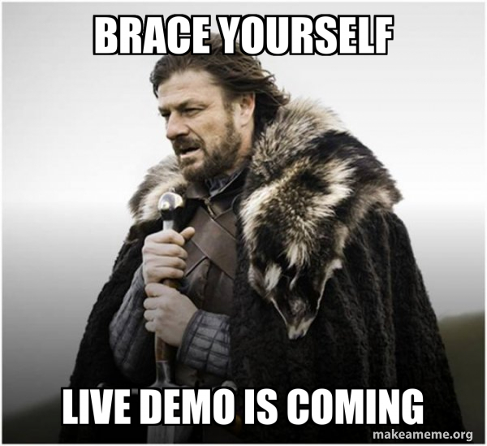

Slide 19
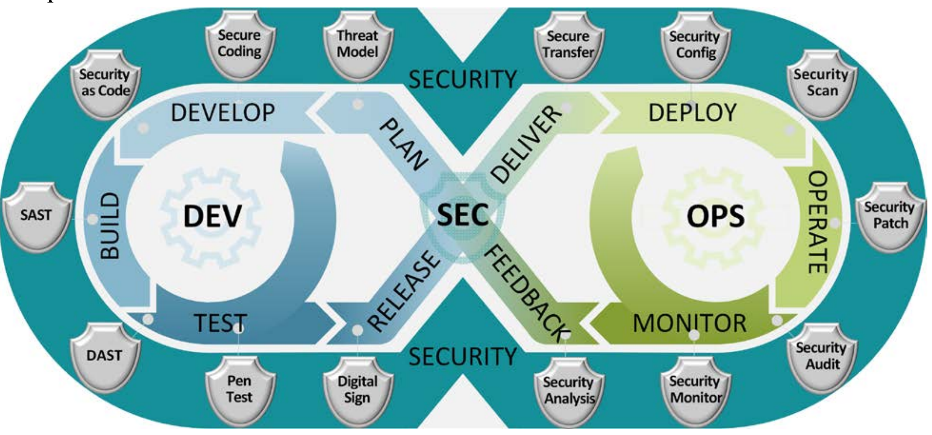

US Department of Defense

Slide 20
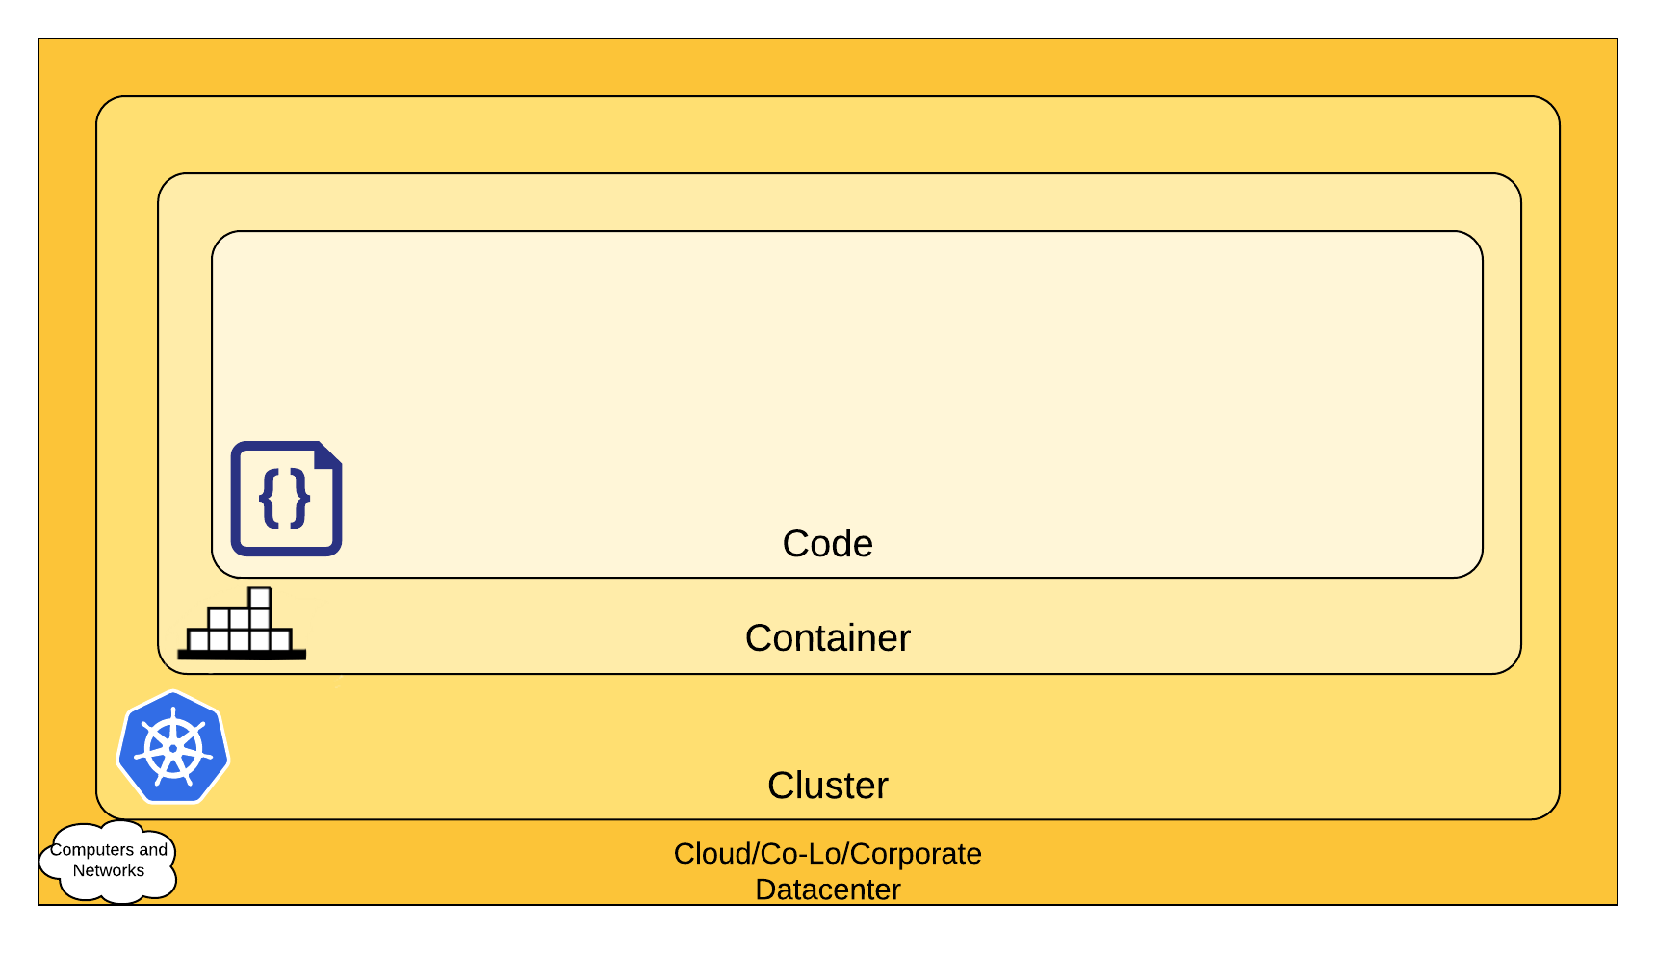

Slide 21
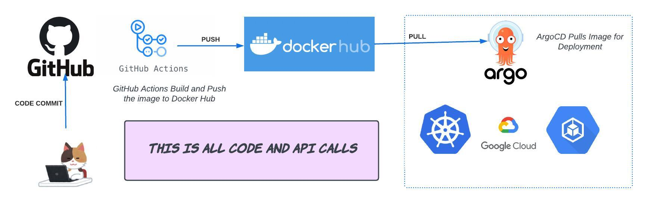

Slide 22
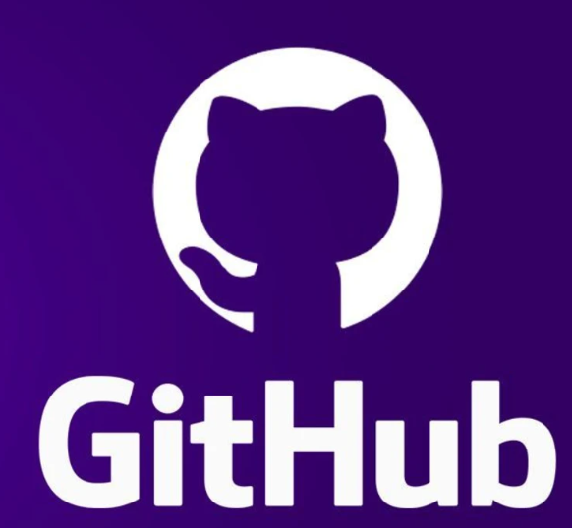

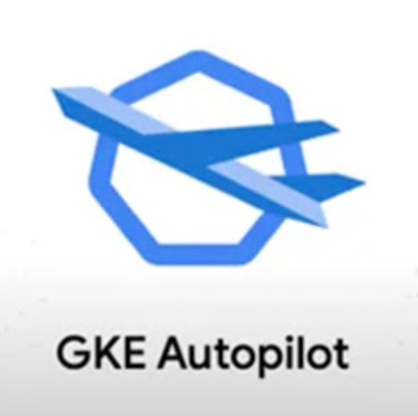


Slide 23
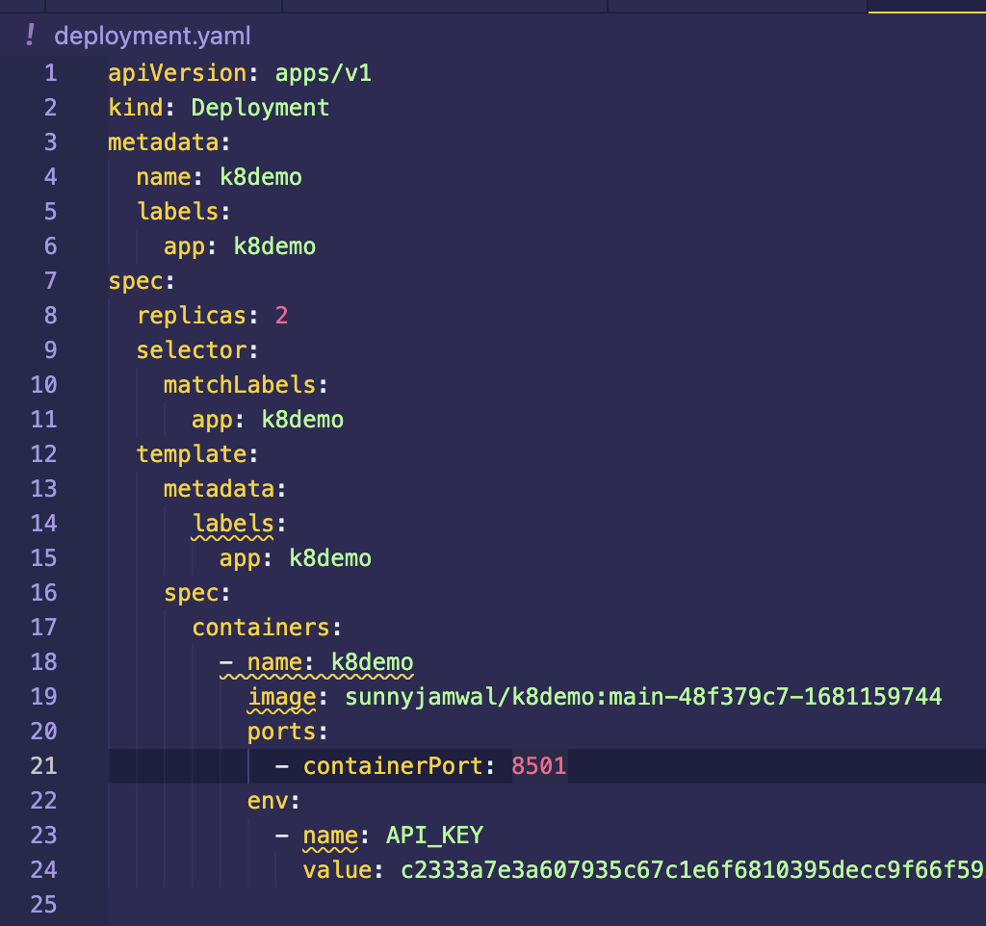
Code
Everything is Code
Application Code, Infrastructure Code and Configuration Code
Code Analysis

Slide 24
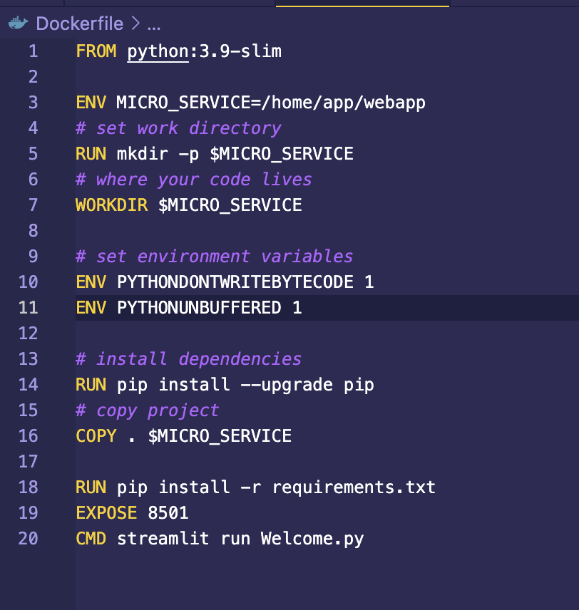
Container
Standardize container images
Use official and current images.
Regularly scan Images
Don’t run as a root
Read-only root filesystem

Slide 25
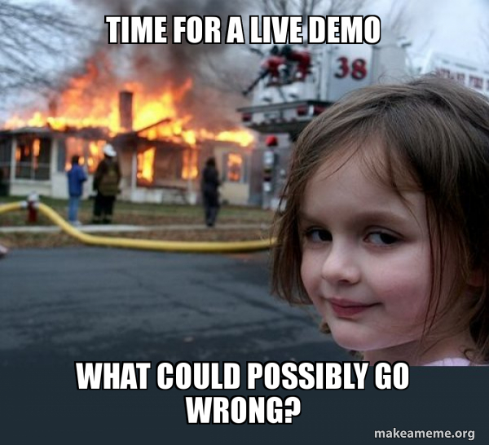

Slide 26
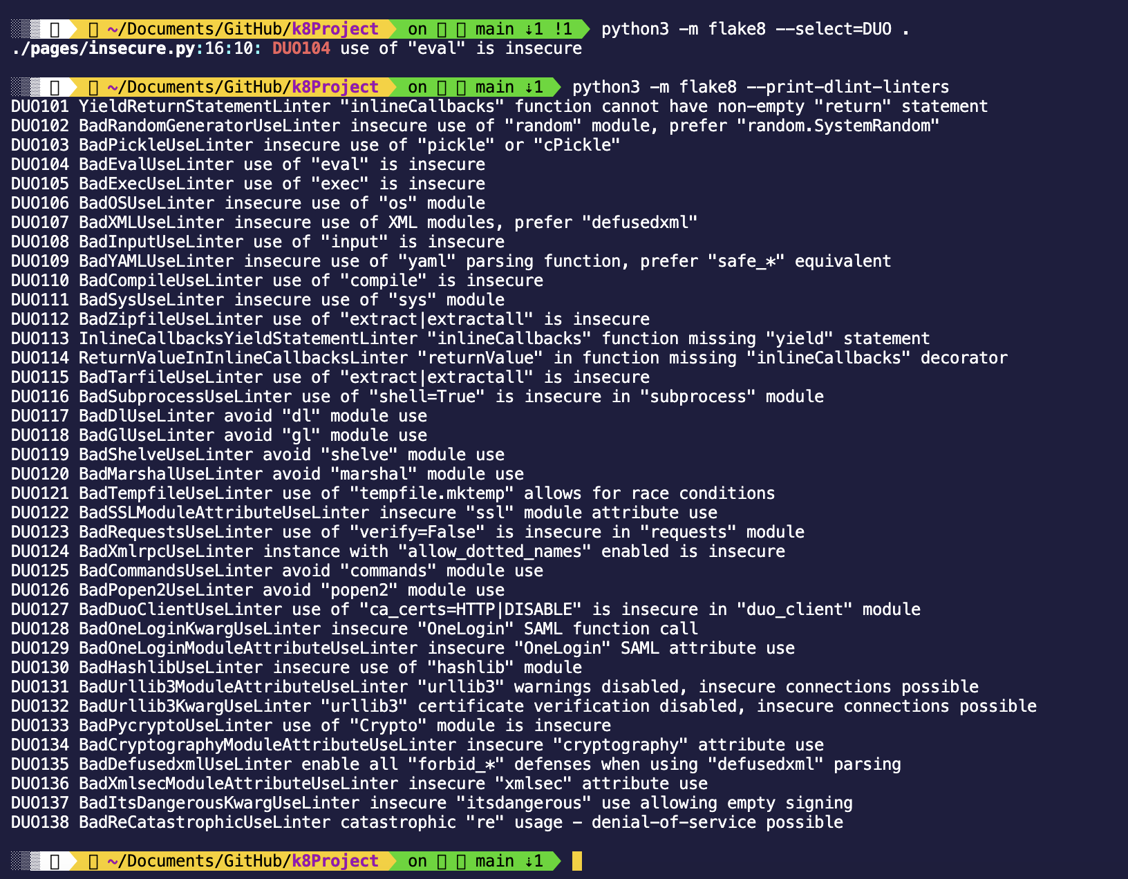

Slide 27
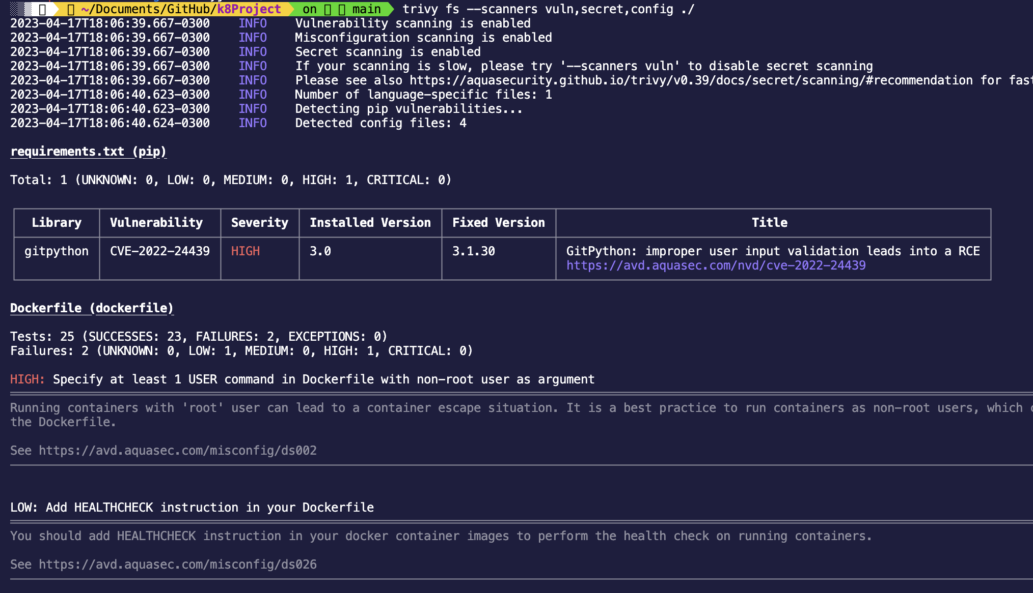

Slide 28
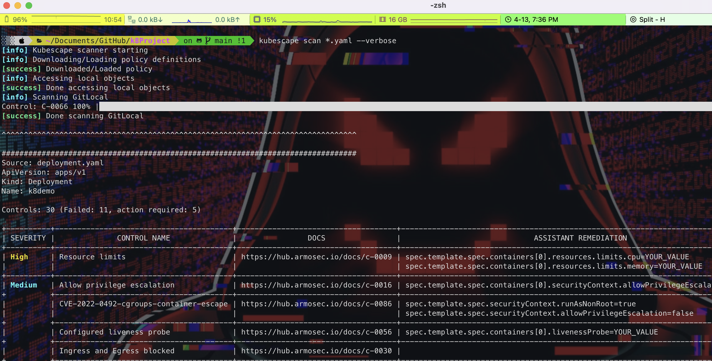

Slide 29
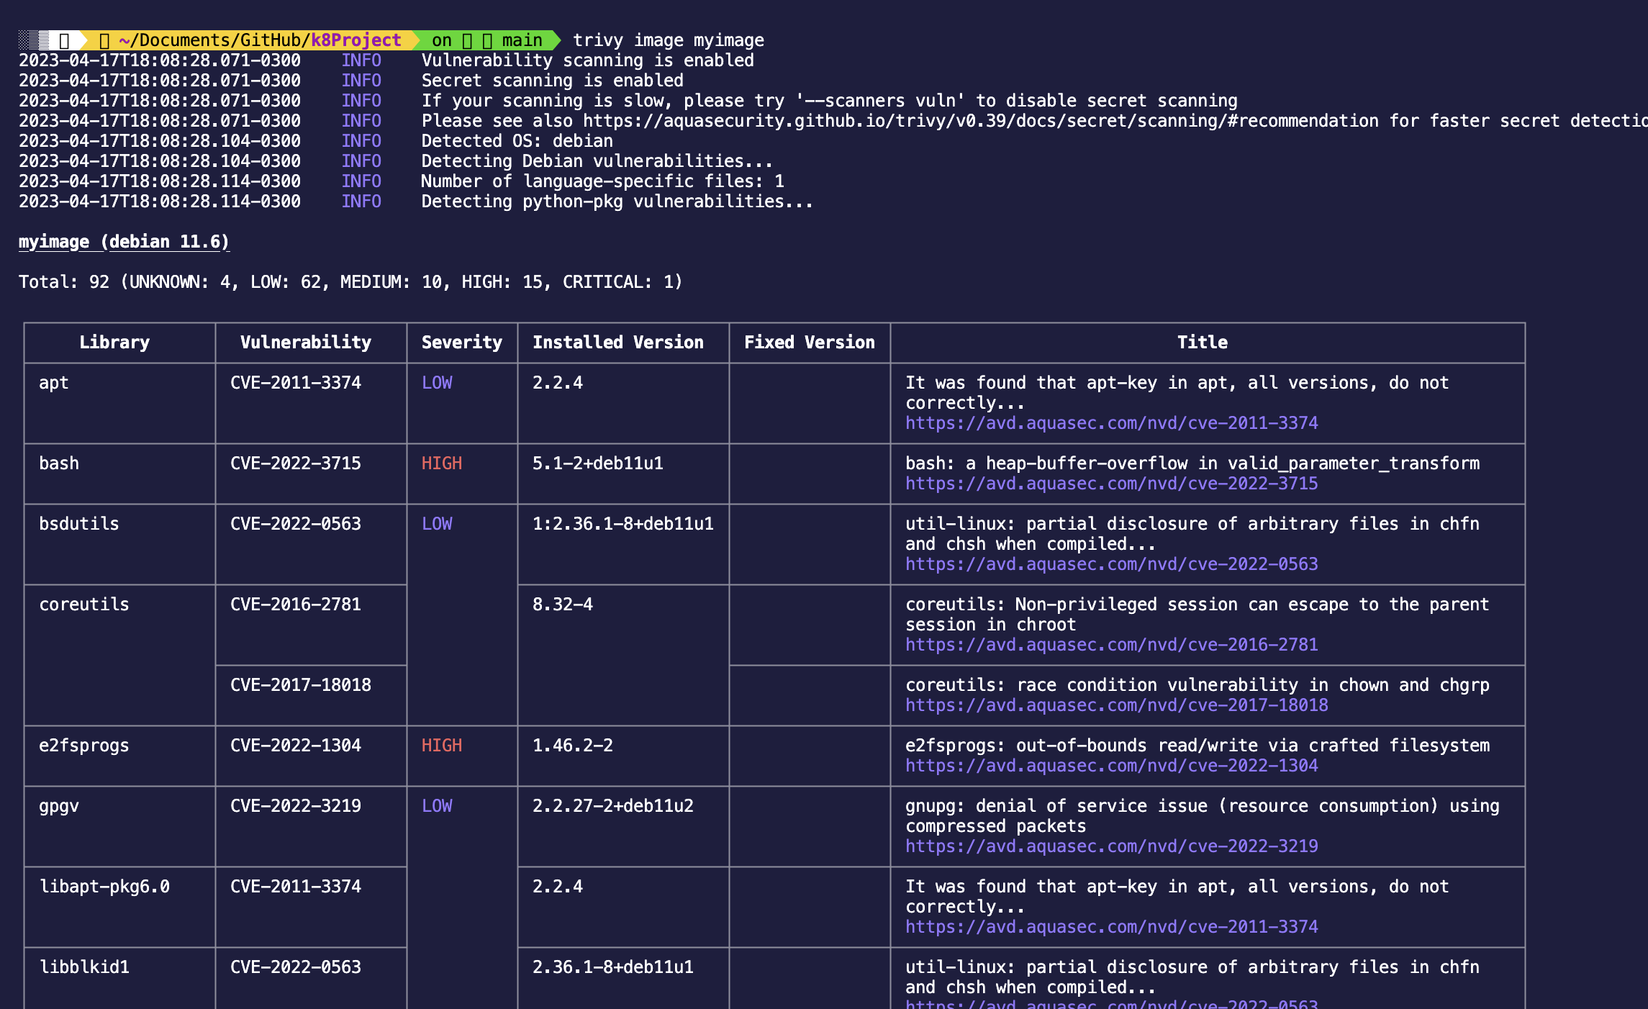

Slide 30
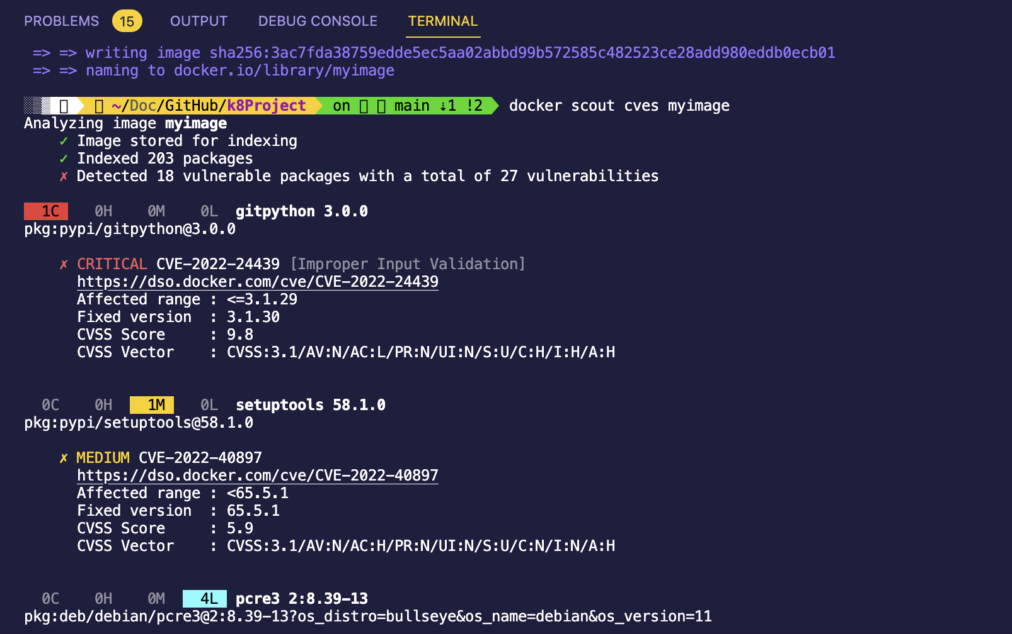

Slide 31
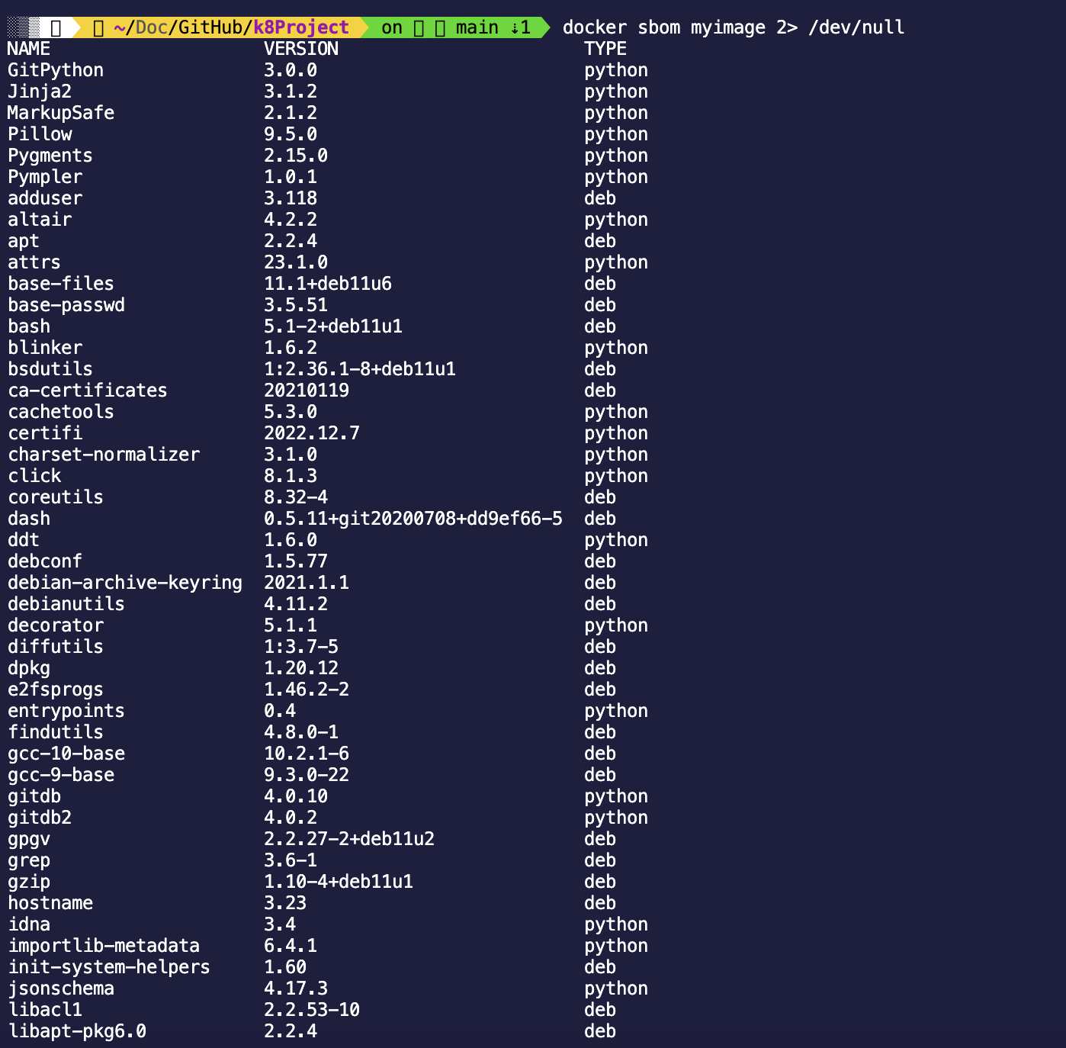

Slide 32
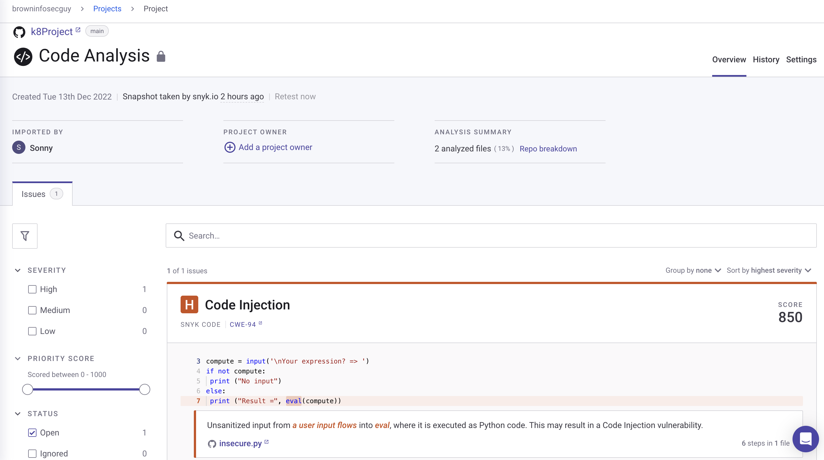

Slide 33
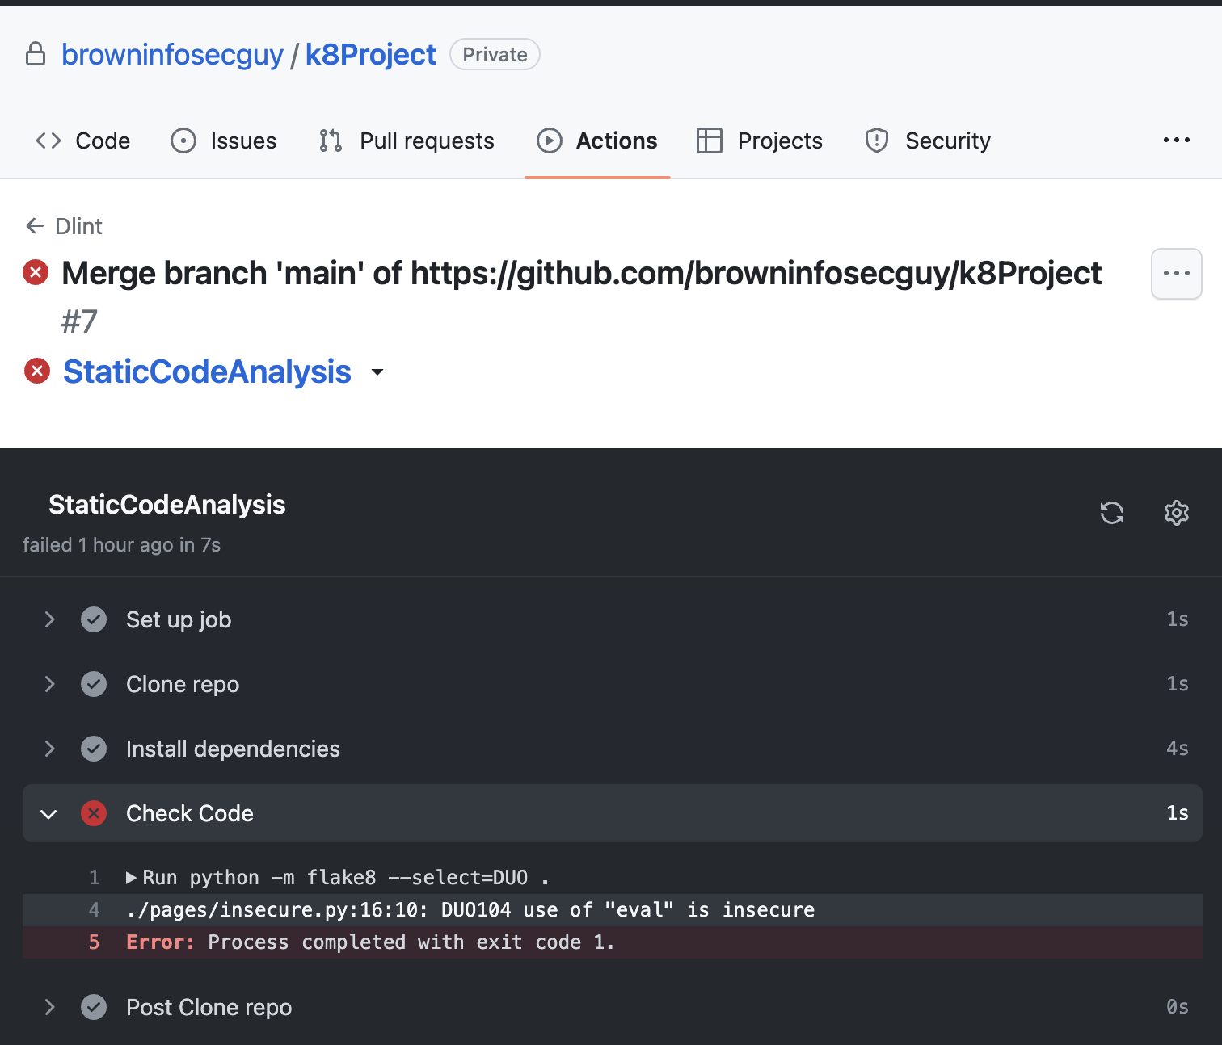

Slide 34
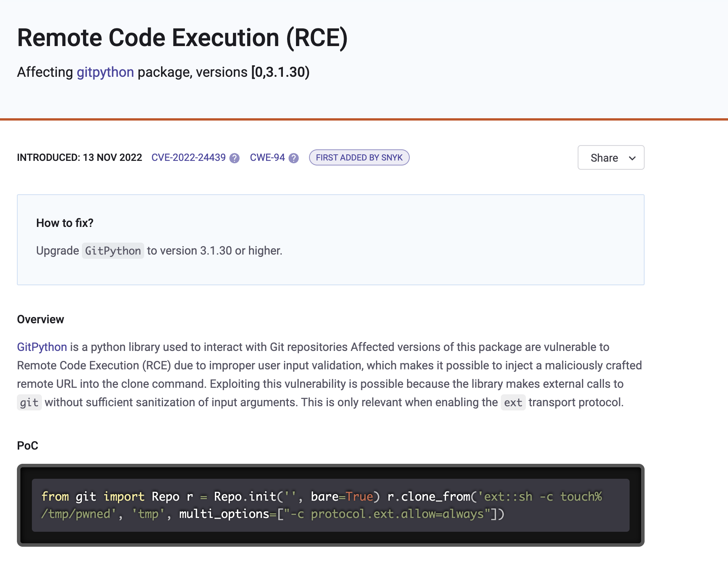

Slide 35
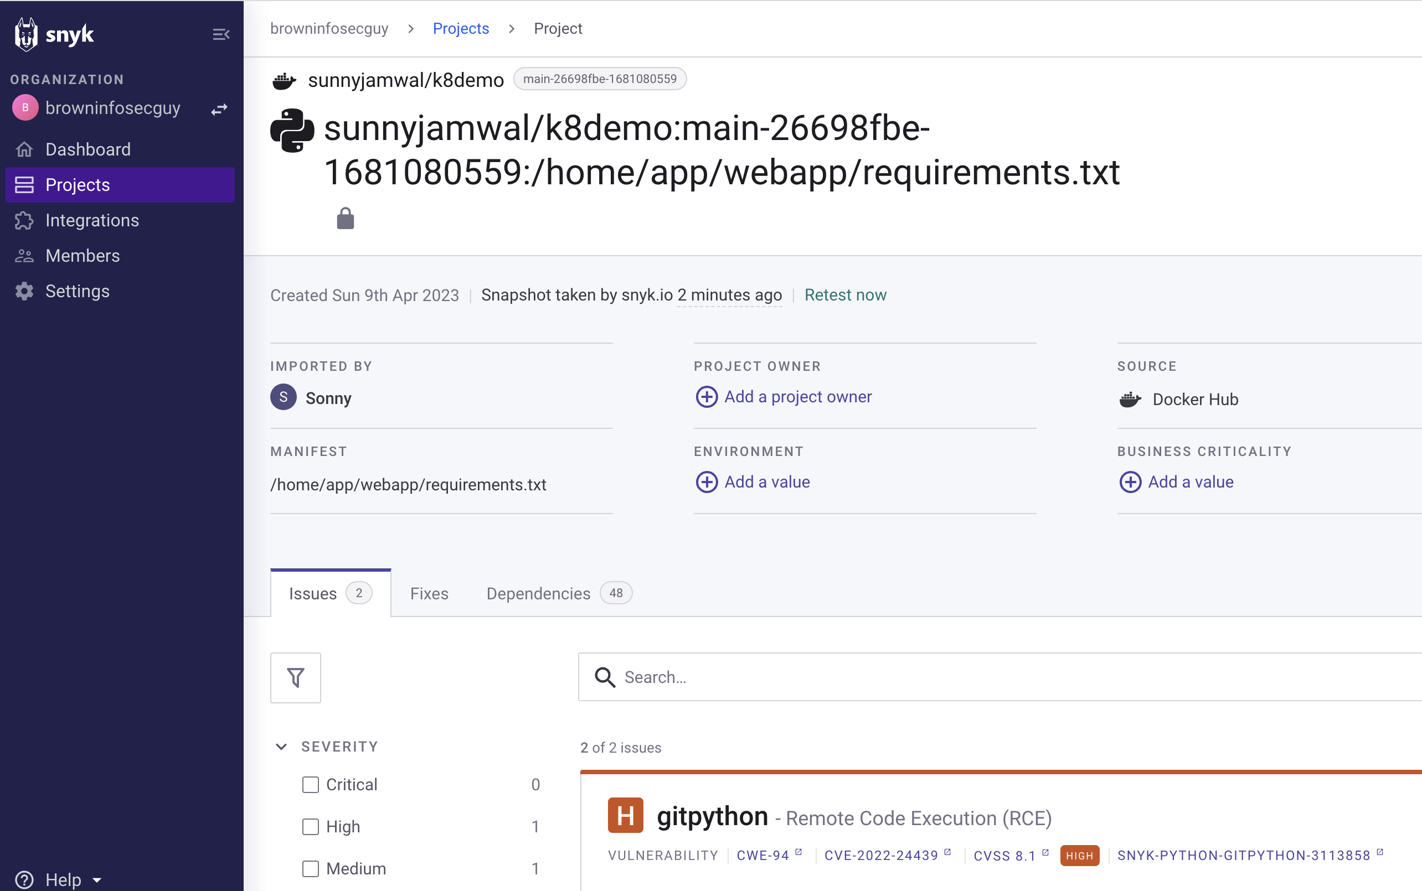

Slide 36
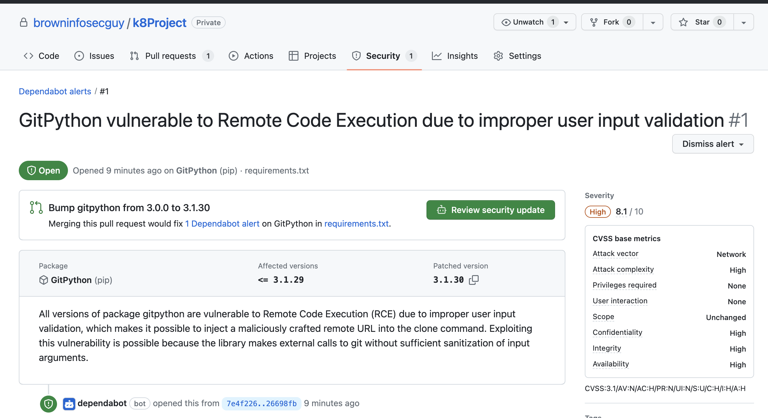

Slide 37
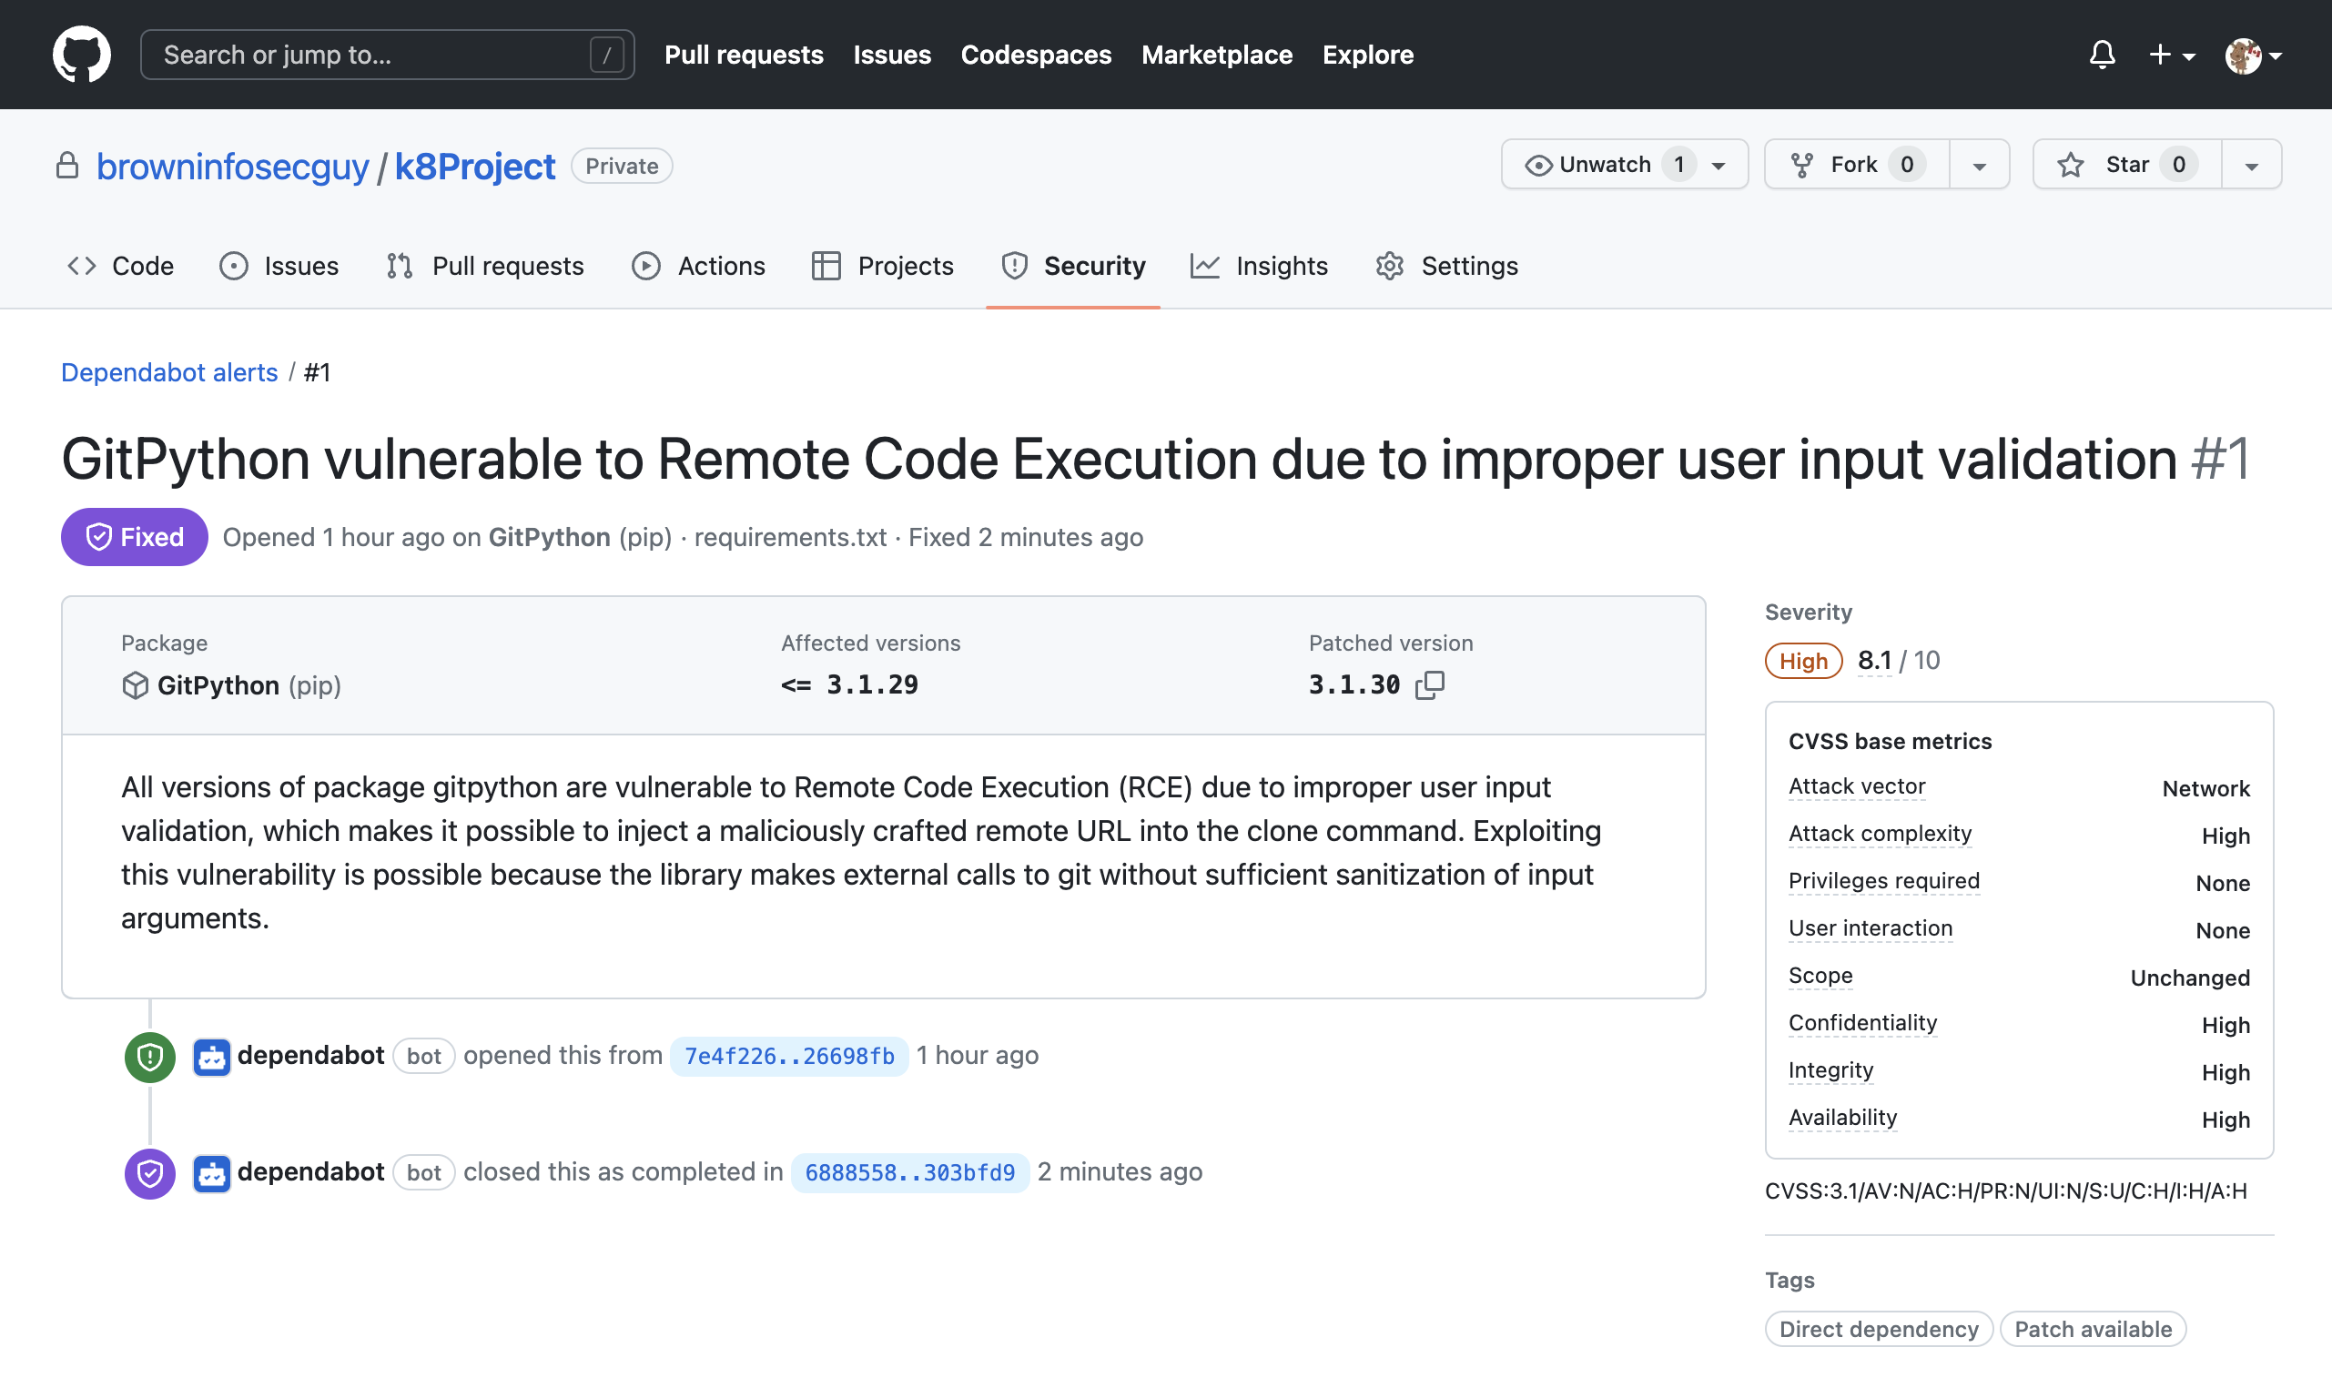

Slide 38
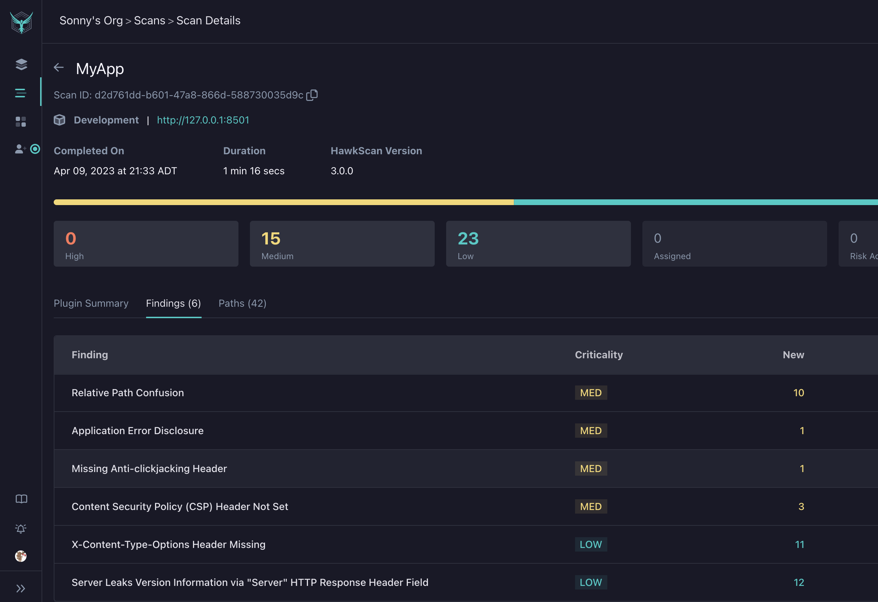

Slide 39
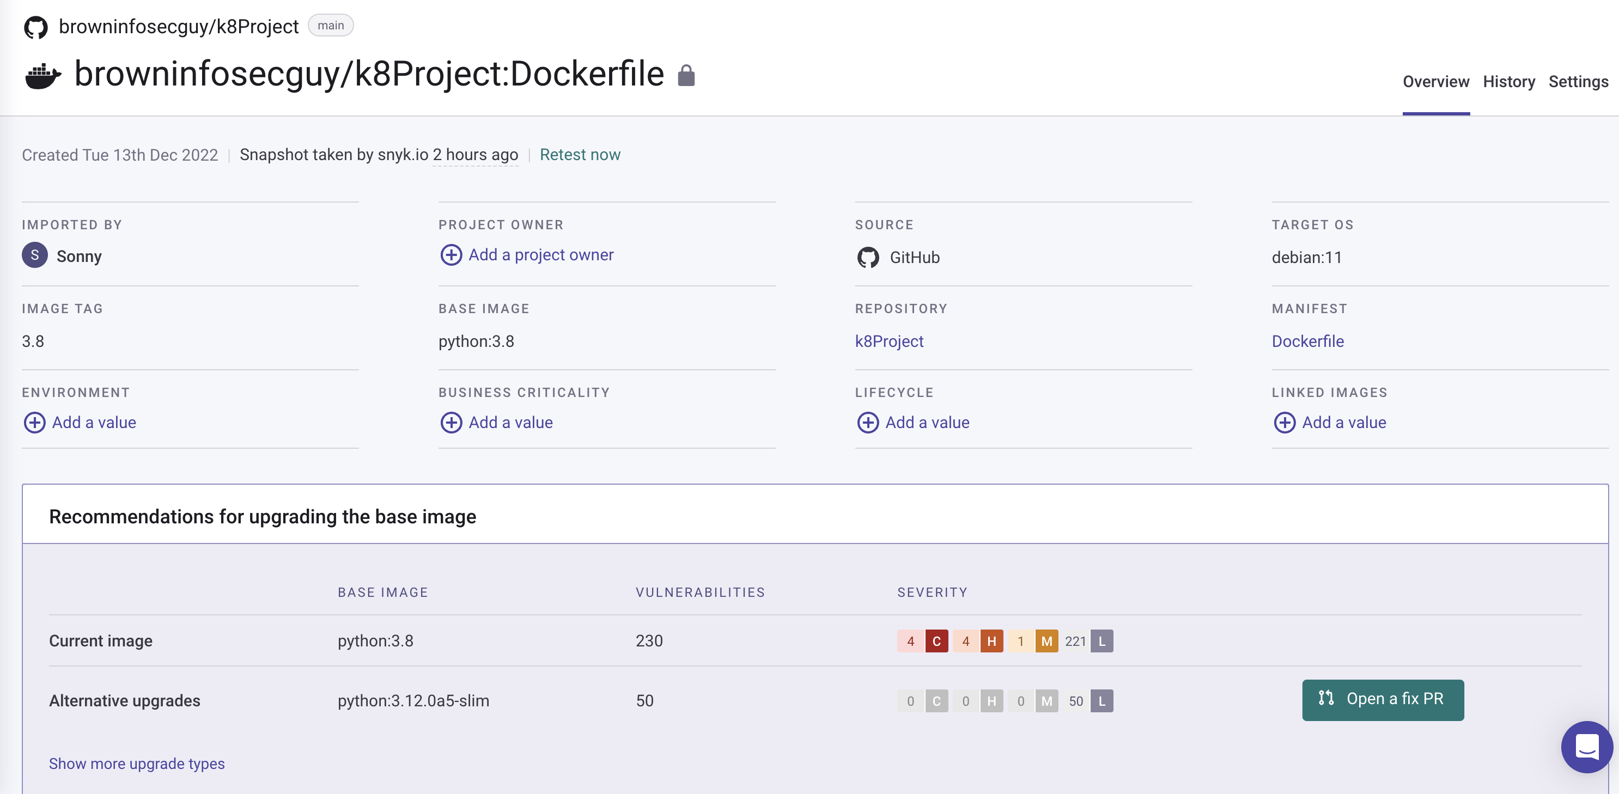

Slide 40
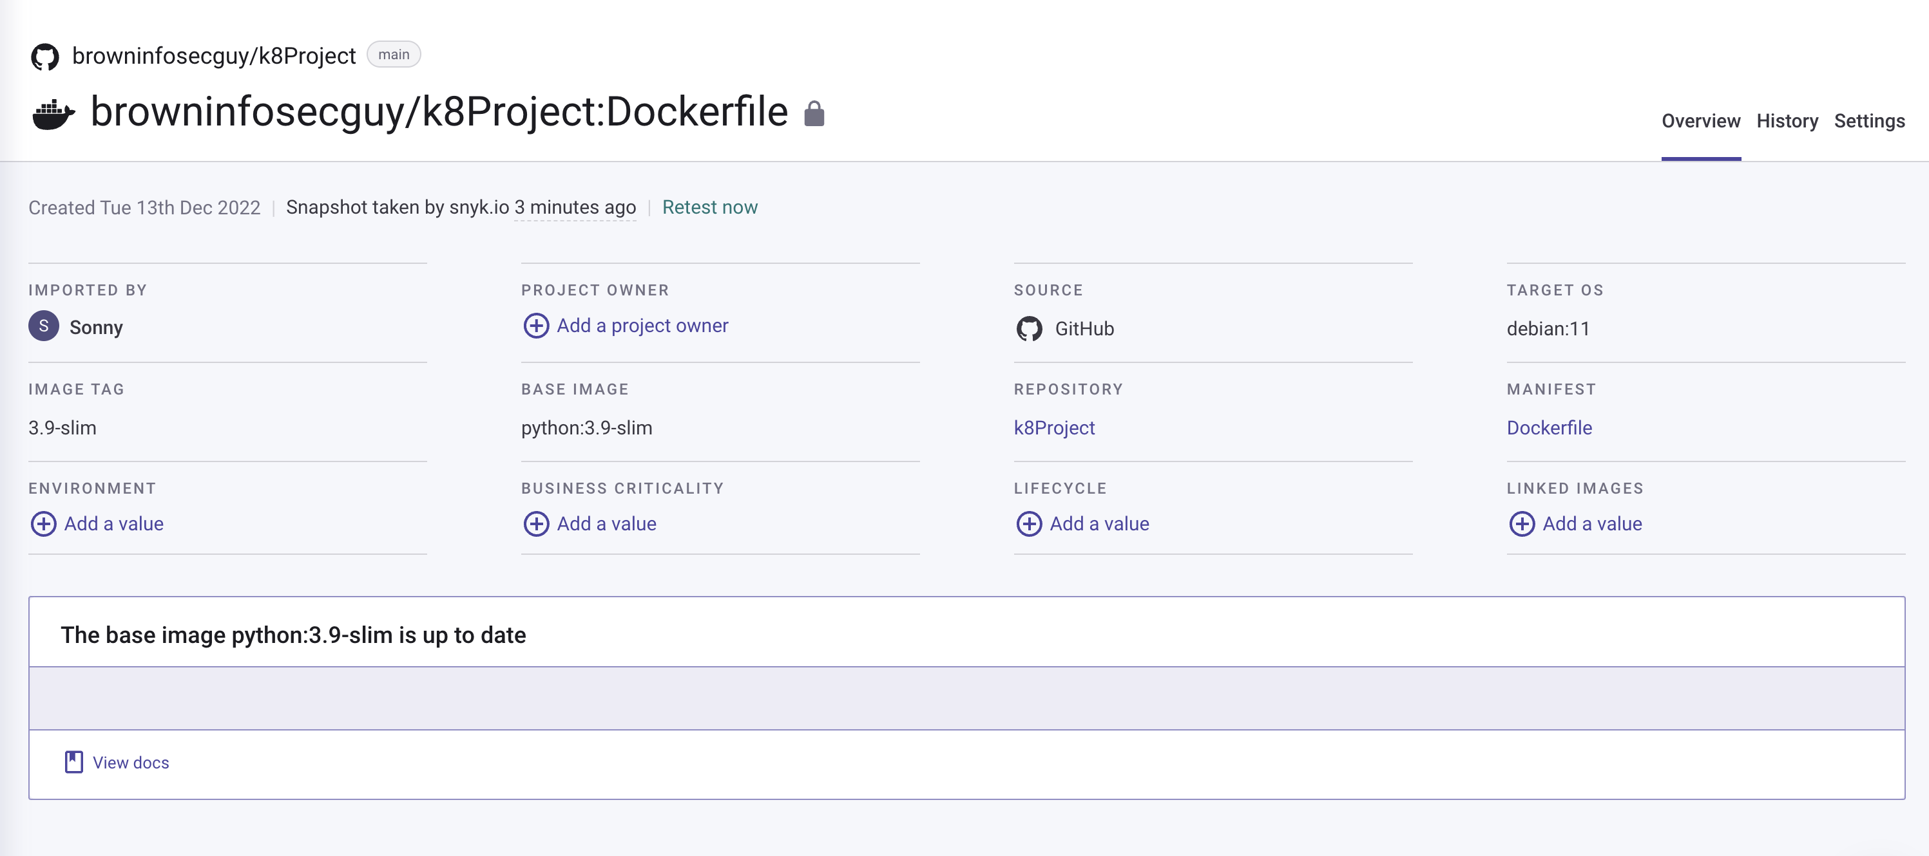

Slide 41
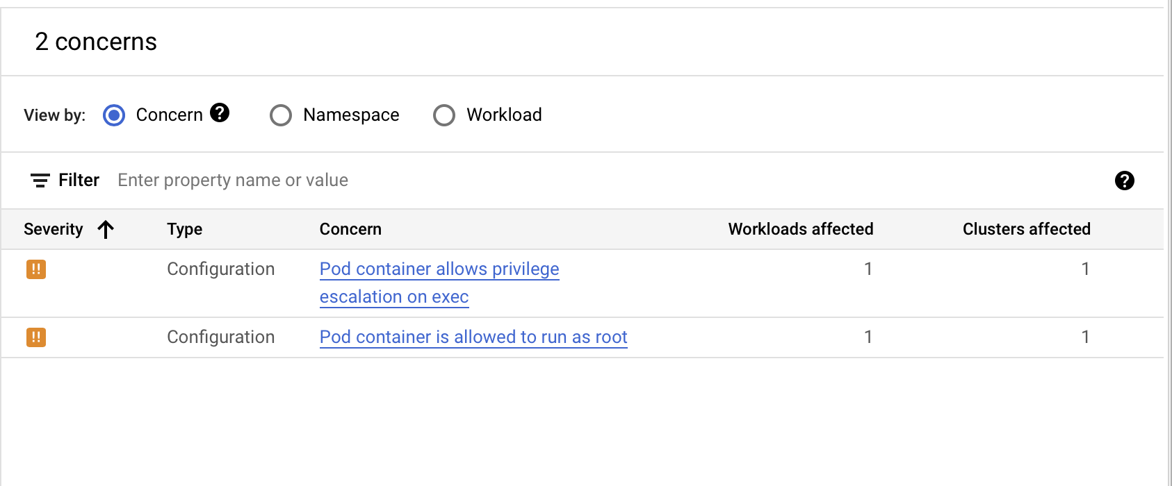

Slide 42
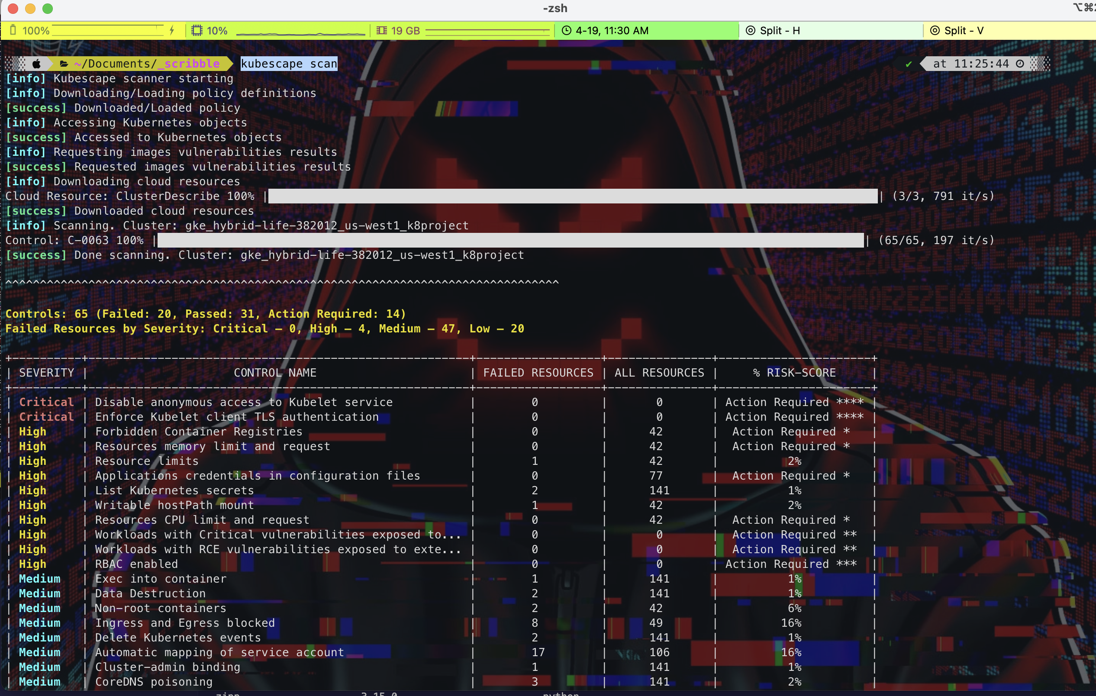

Slide 43
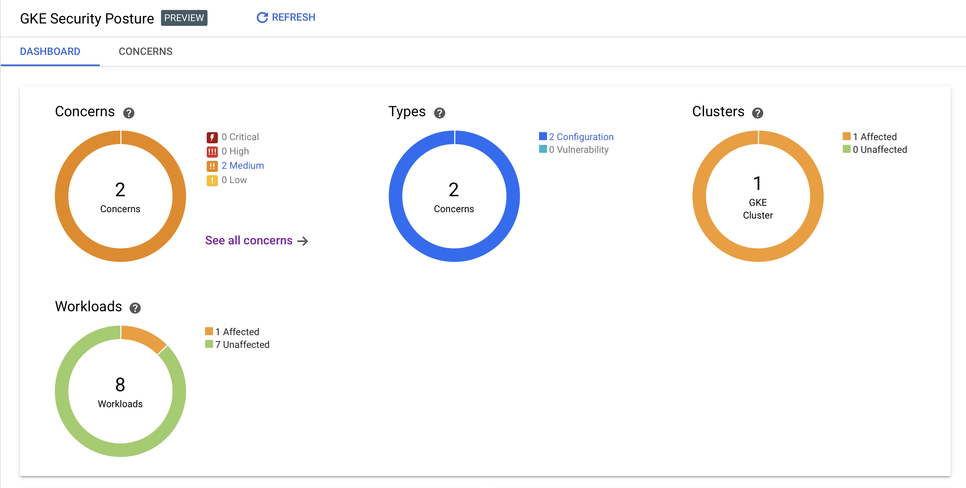

Slide 44
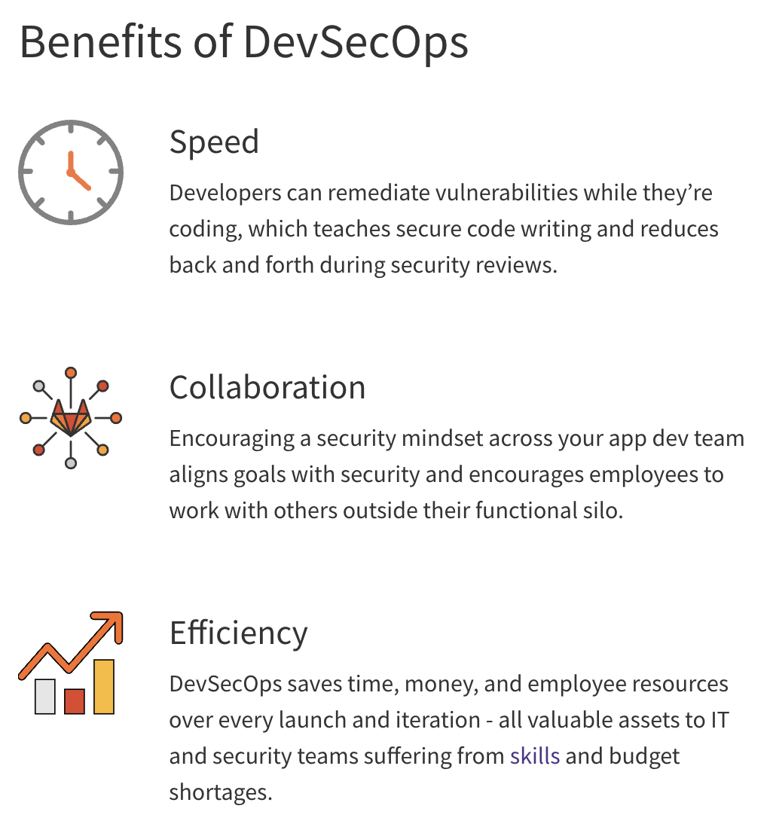
Recommendations:
Automate Security.
Implement API Governance Program.
Standardize Container Images.
Implement secure code scan at PR (pull request) level.
Software Bill of Material (SBOM).
Peer Code review.
Make CI/CD Pipeline less Complex.

Slide 45
Thanks!!! Questions?

Slide 46
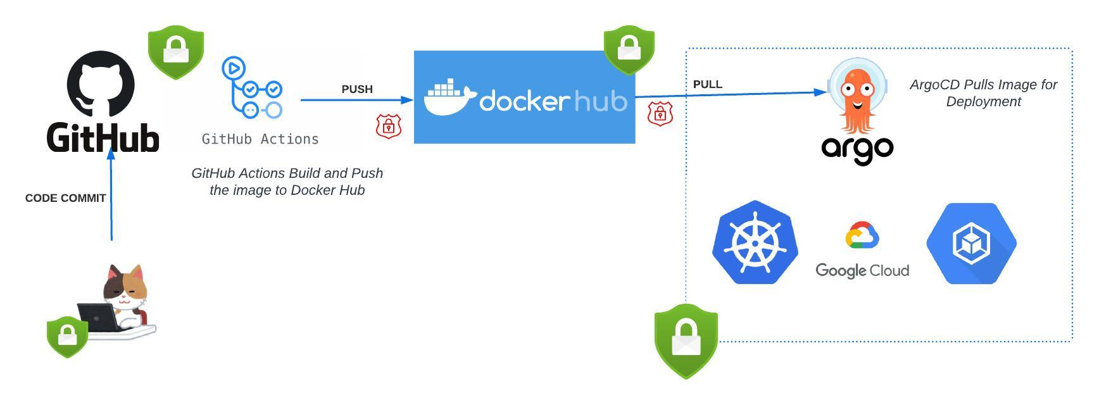

Slide 47
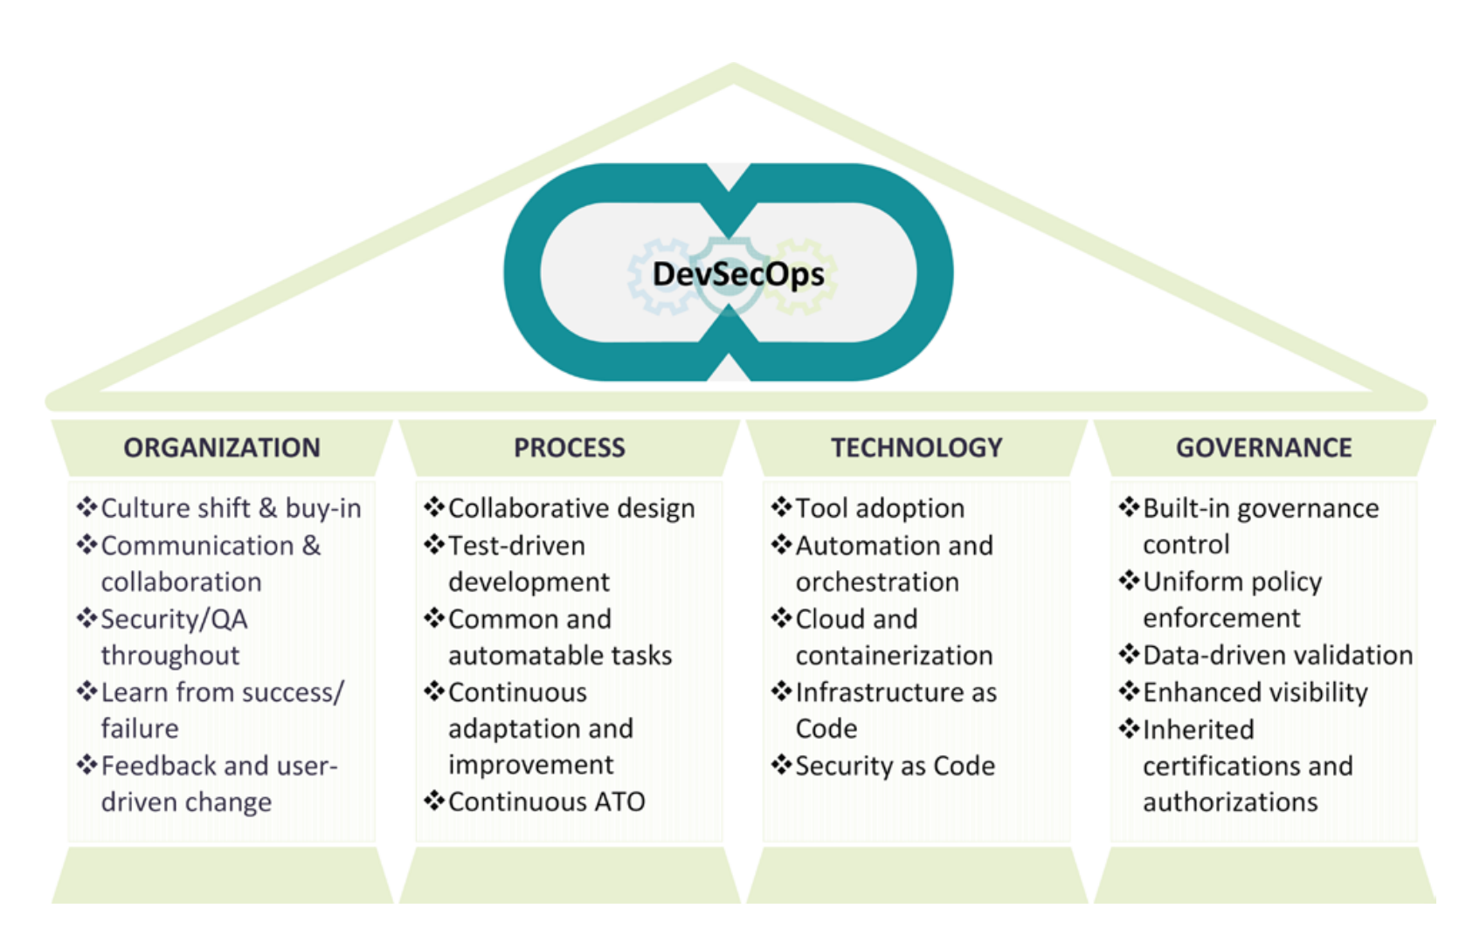

Slide 48
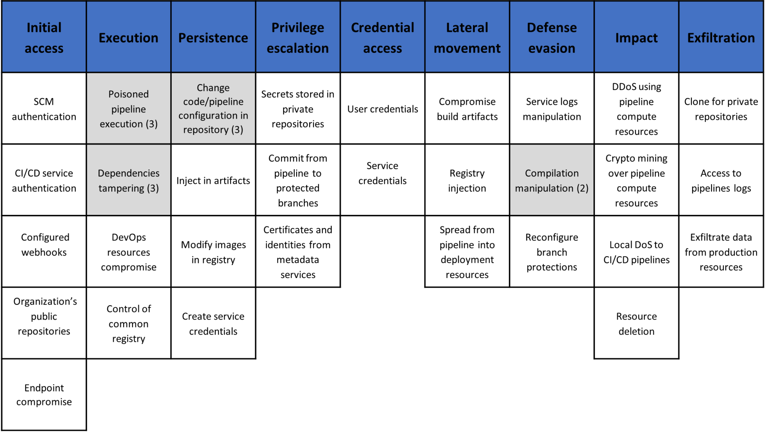
Source: https://www.microsoft.com/en-us/security/blog/2023/04/06/devops-threat-matrix/

